Slide 1
Spring 2017 data analysis

Slide 2
Research Question
What are the joint effects of performance and solution transparency on the innovation outcome?

Slide 3
Hypotheses [ this is to be improved based on theory ]
Full transparency has the highest innovation performance compared to all 3 of the other treatment groups
Full transparency has the highest effort compared to all 3 of the other treatment groups
Full transparency has a higher total score of the apps being clicked across all phases compared to solution transparency
Full transparency has a higher number of clicks assigned to an app compared to solution transparency
Full transparency has a higher number of clicks done by a person compared to solution transparency

Slide 4
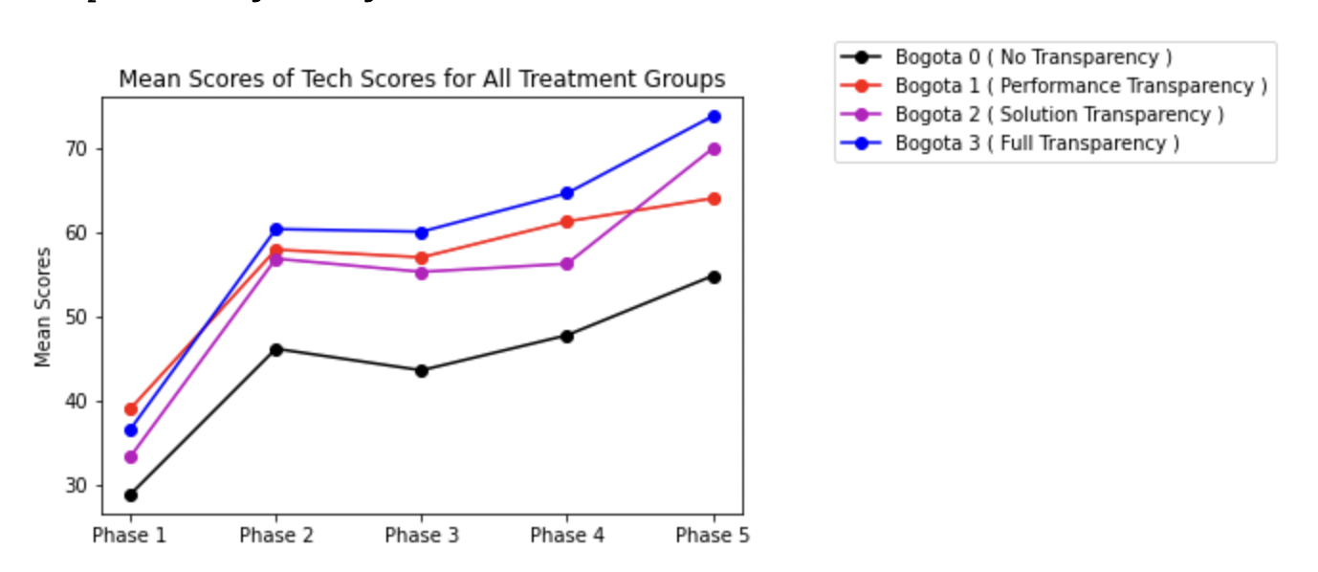
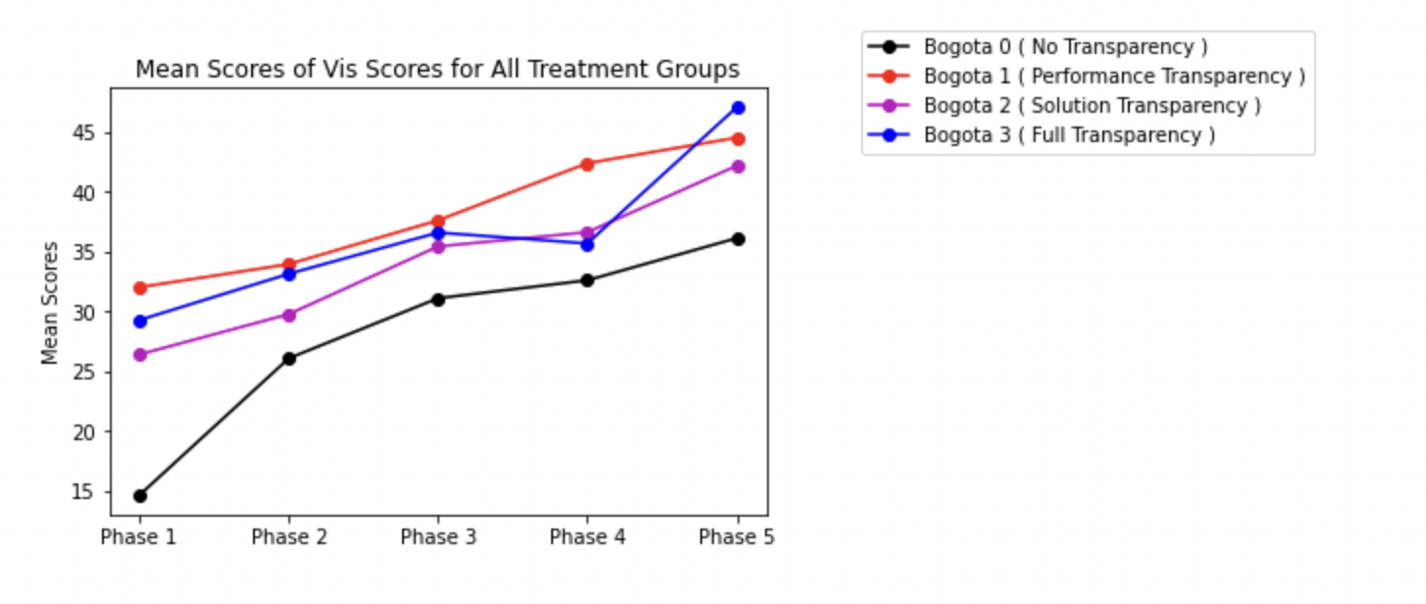
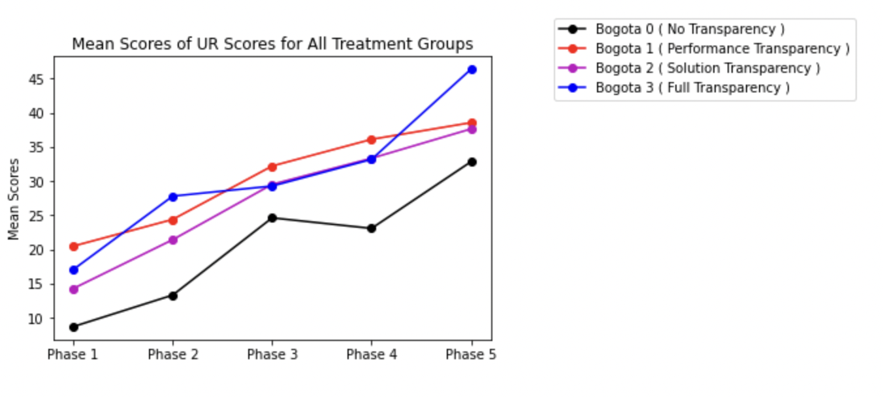
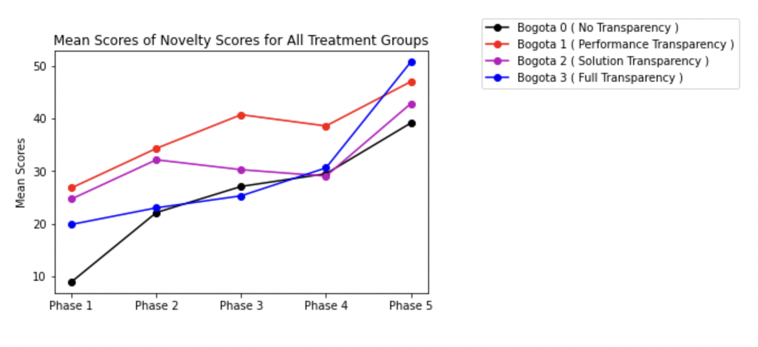
Line Plot of scores in 4 dimensions
Ref Link to Notebook - https://github.com/ironhacks/analysis-2017/blob/main/spring-2017/script/analysis/BoxPlots-LineCharts-BarCharts(Scores%2CLOC%2CD3%2CSurvey).ipynb

Slide 5
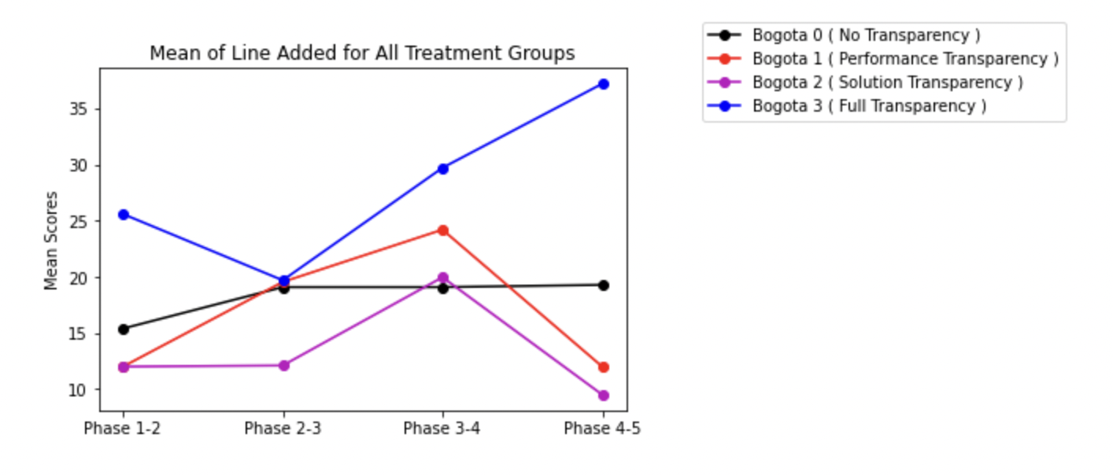
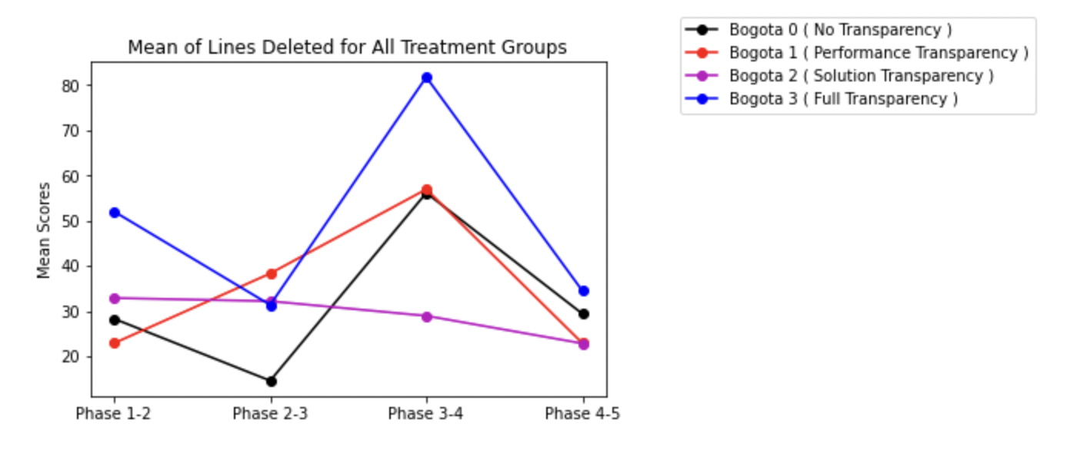
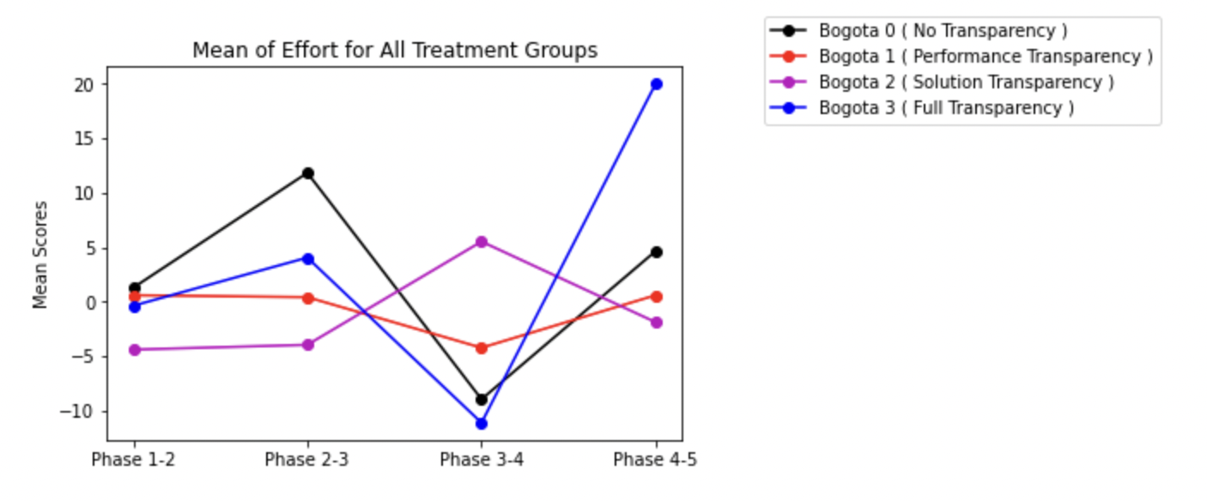
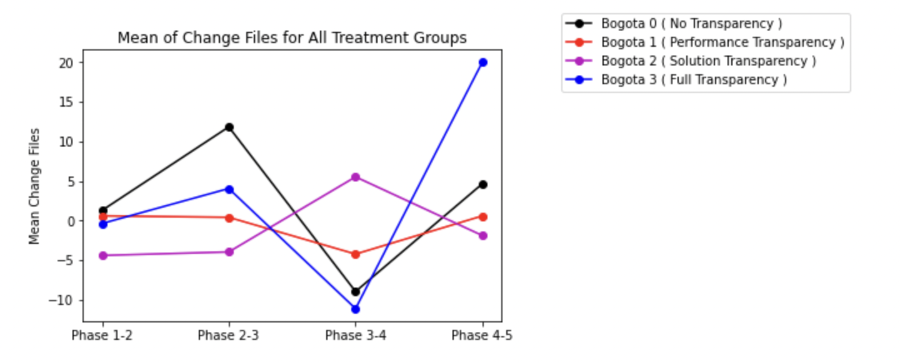
Lines added/deleted/effort/files change
Ref Link to Notebook - https://github.com/ironhacks/analysis-2017/blob/main/spring-2017/script/analysis/BoxPlots-LineCharts-BarCharts(Scores%2CLOC%2CD3%2CSurvey).ipynb

Slide 6
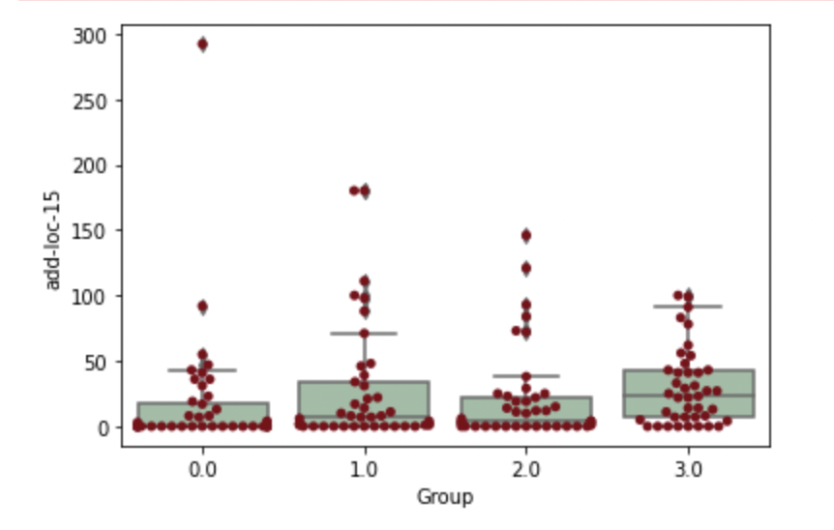
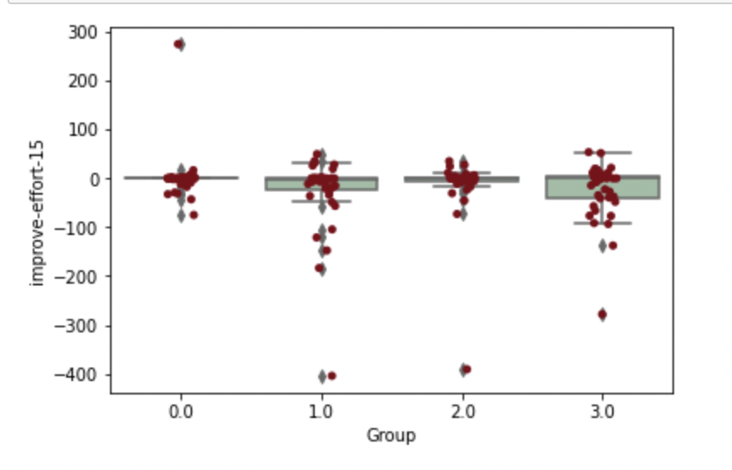
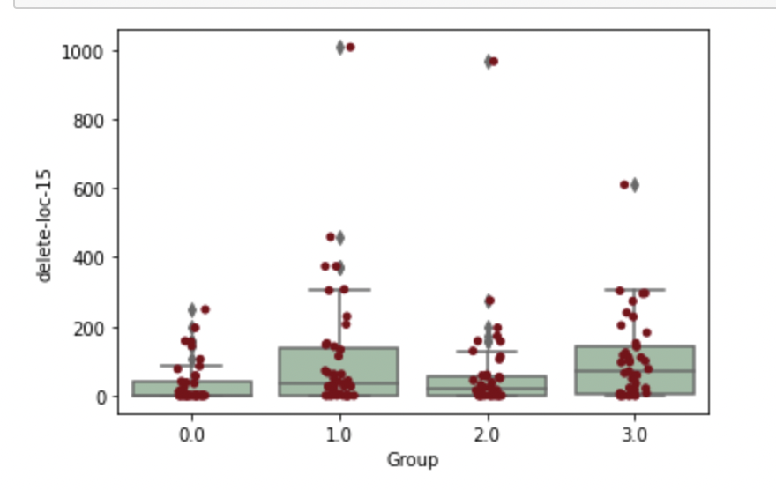
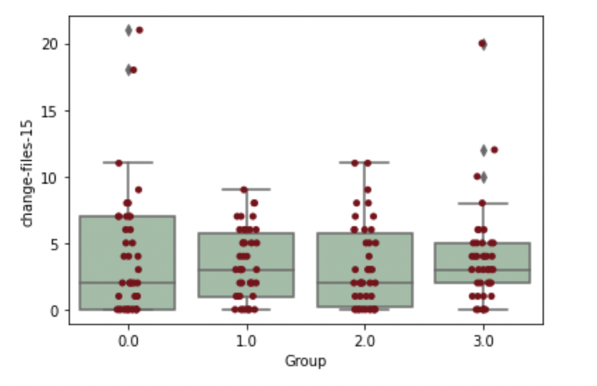
Median Lines added/deleted/effort/files change

Slide 7
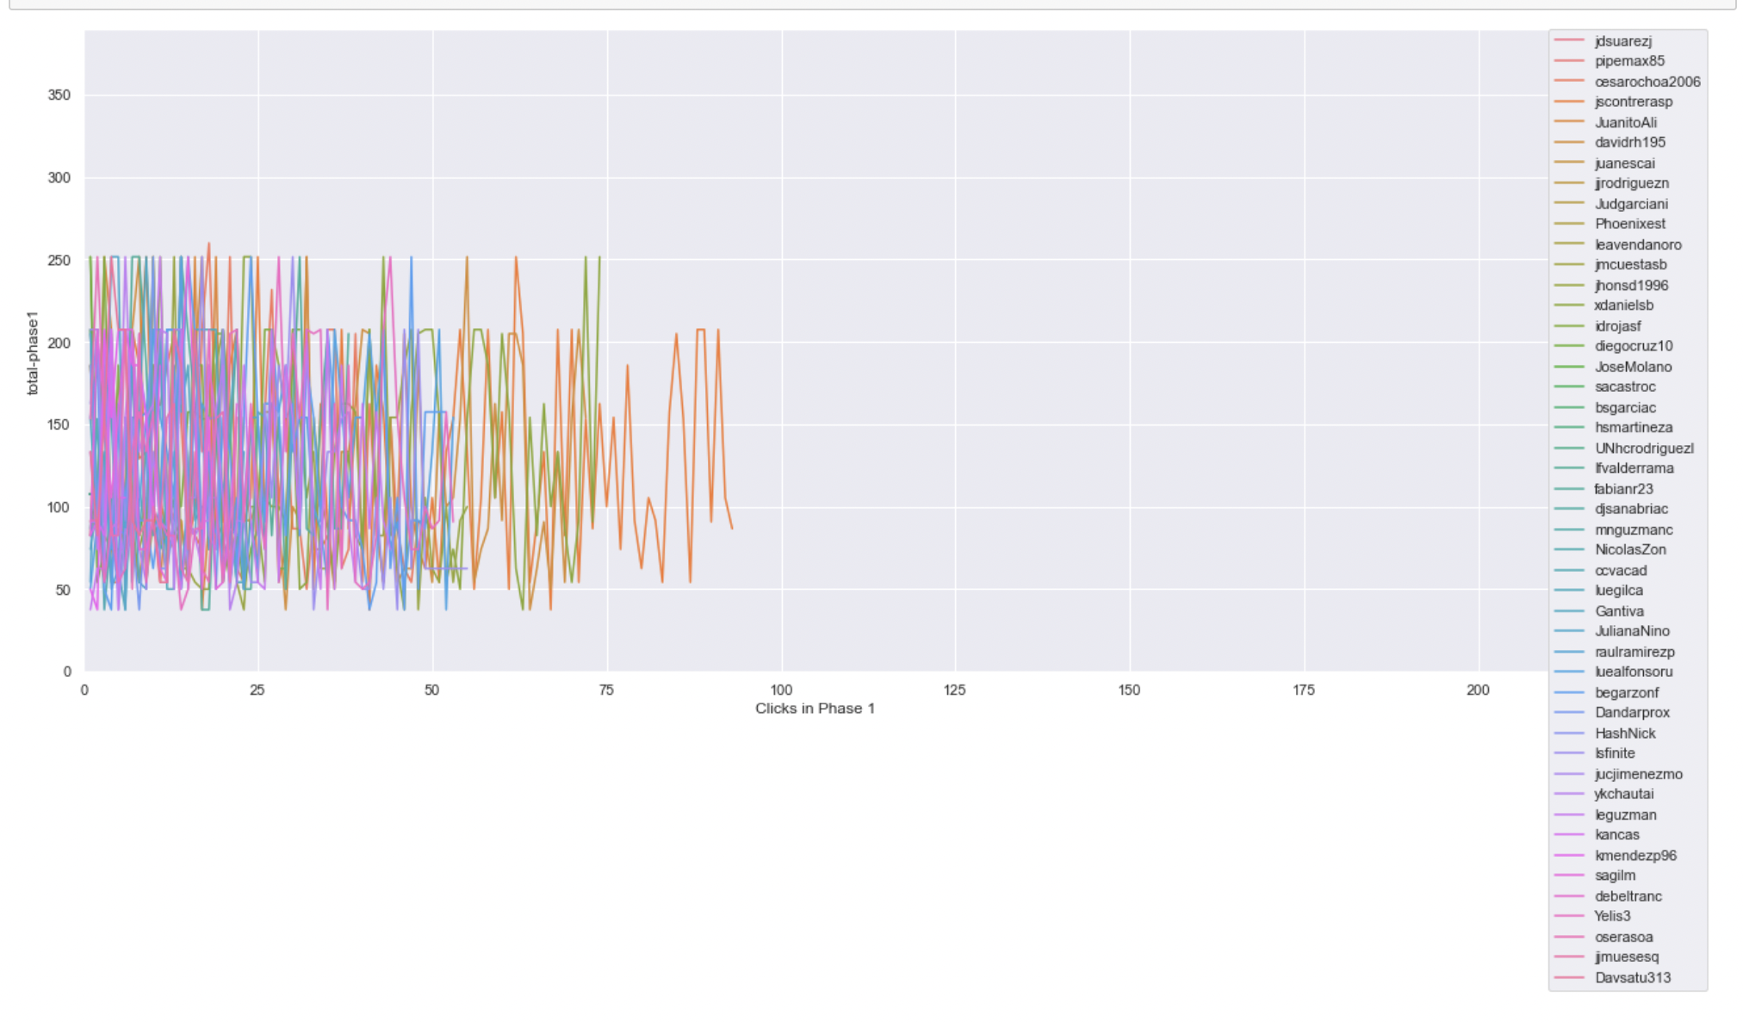
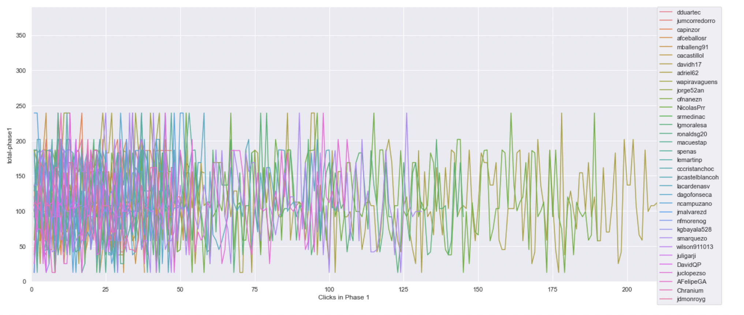
Timeline plot of scores of projects clicked on in phase 1 ( same scale )
Ref Link - https://github.com/ironhacks/analysis-2017/blob/main/spring-2017/script/analysis/Clicks-Analysis(Graphs%2CDescriptive-Analysis).ipynb
Bogota 2 ( Solution Transparency Only ) | Bogota 3 ( Full Transparency )

Slide 8
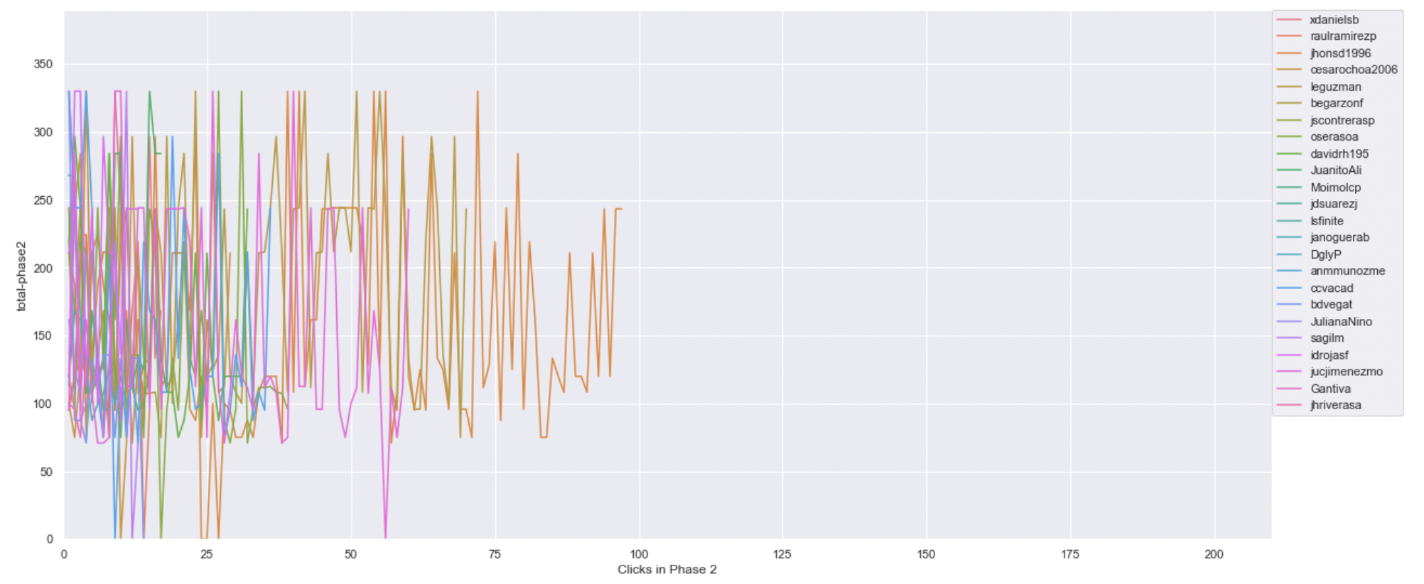
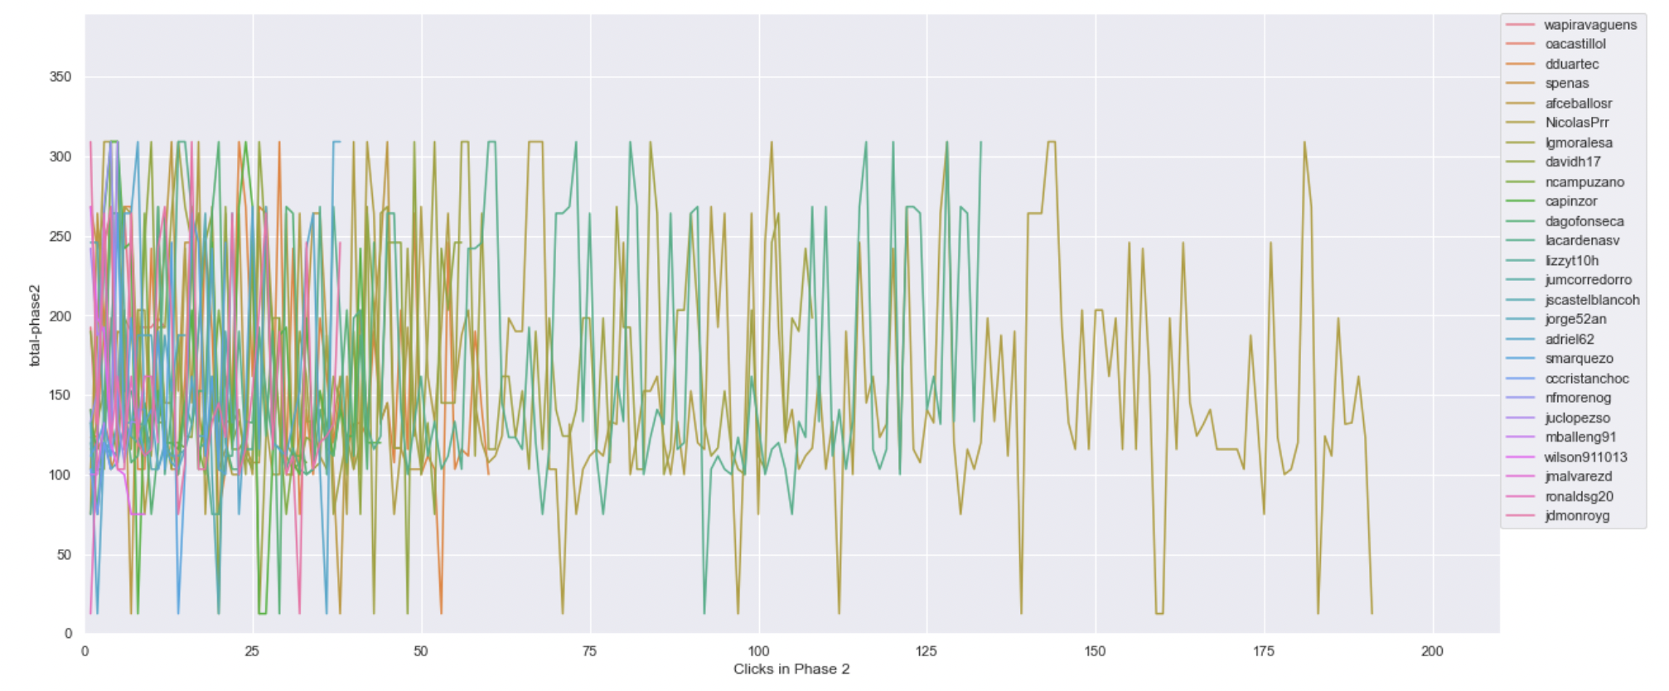
Timeline plot of scores of projects clicked on in phase 2 ( same scale )
Ref Link - https://github.com/ironhacks/analysis-2017/blob/main/spring-2017/script/analysis/Clicks-Analysis(Graphs%2CDescriptive-Analysis).ipynb
Bogota 2 ( Solution Transparency Only ) | Bogota 3 ( Full Transparency )

Slide 9
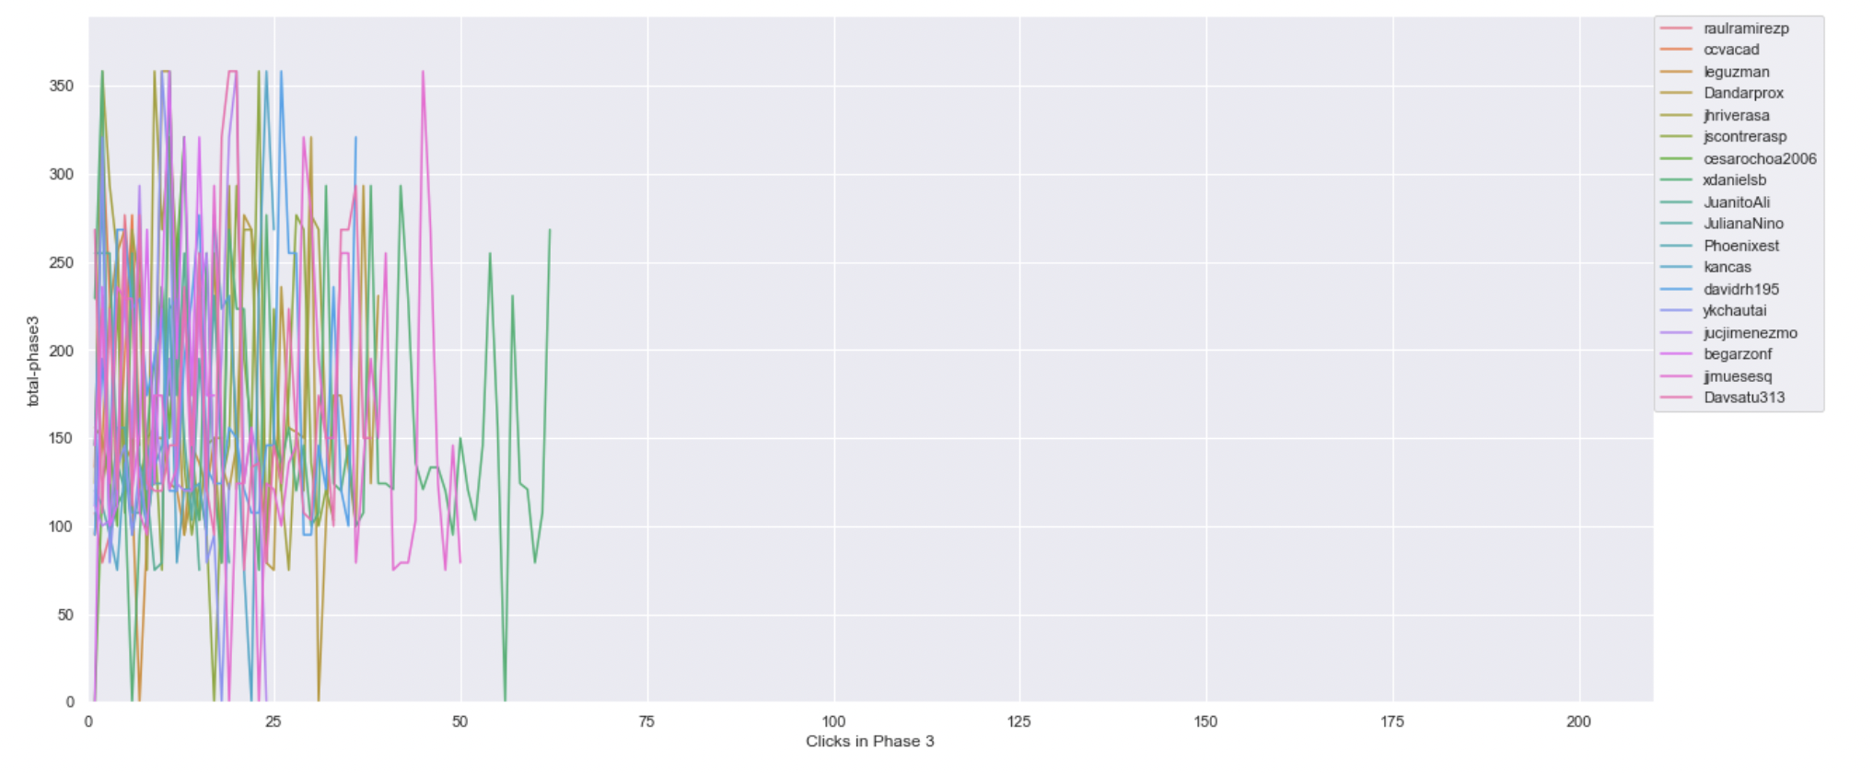
Timeline plot of scores of projects clicked on in phase 3 ( same scale )
Ref Link - https://github.com/ironhacks/analysis-2017/blob/main/spring-2017/script/analysis/Clicks-Analysis(Graphs%2CDescriptive-Analysis).ipynb
Bogota 2 ( Solution Transparency Only ) | Bogota 3 ( Full Transparency )

Slide 10
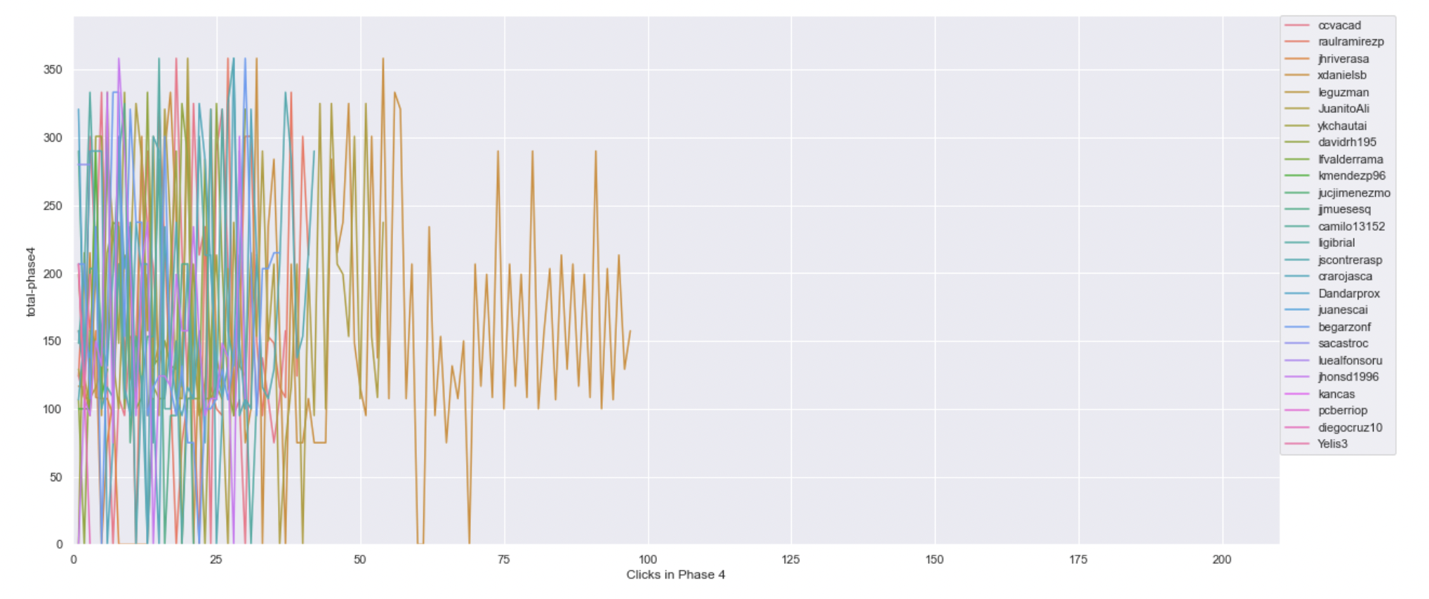
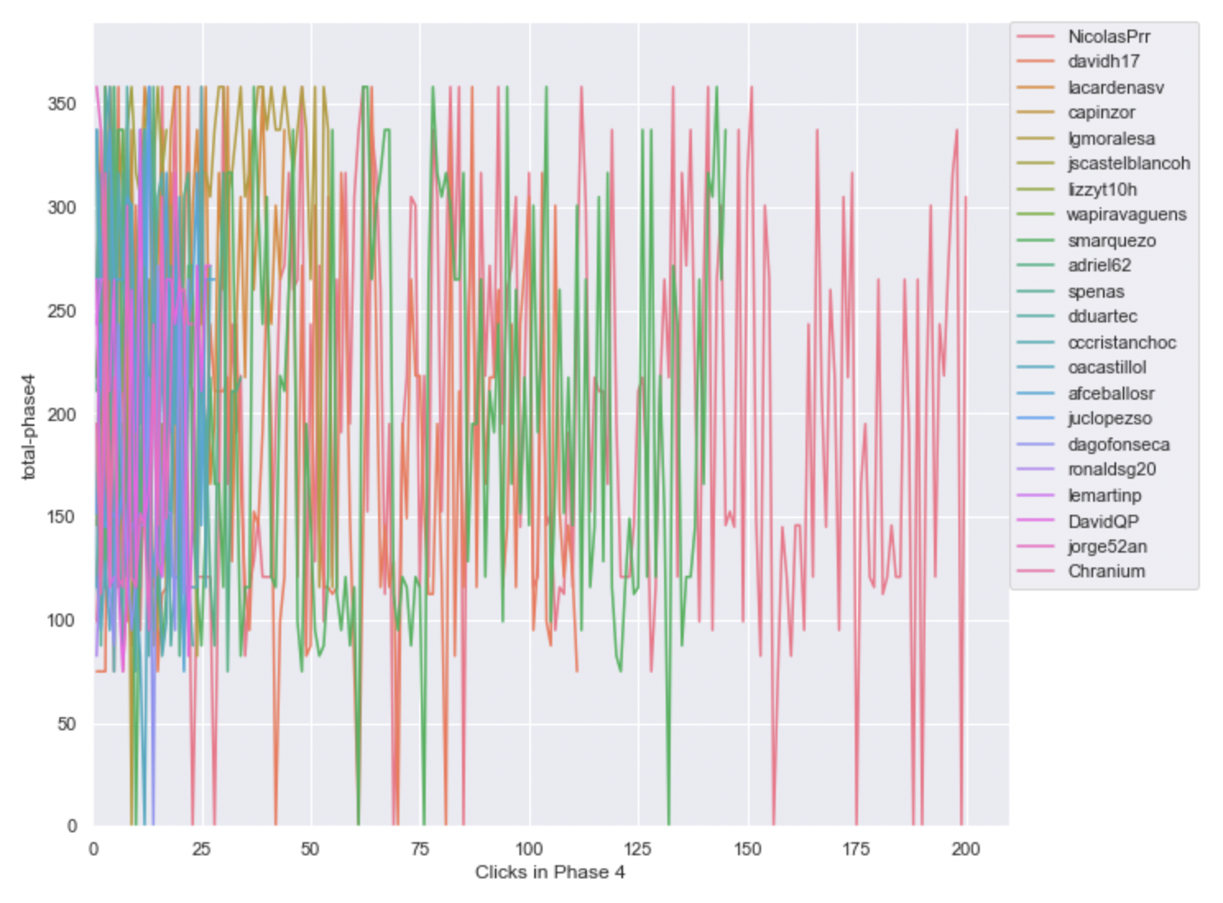
Timeline plot of scores of projects clicked on in phase 4 ( same scale )
Ref Link - https://github.com/ironhacks/analysis-2017/blob/main/spring-2017/script/analysis/Clicks-Analysis(Graphs%2CDescriptive-Analysis).ipynb
Bogota 2 ( Solution Transparency Only ) | Bogota 3 ( Full Transparency )

Slide 11
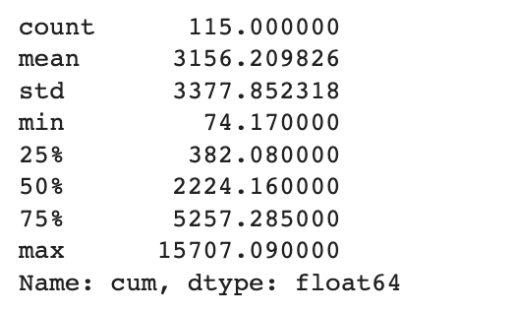
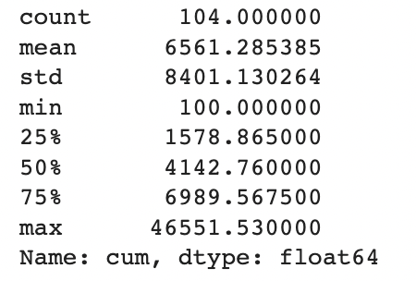
Total Score of the Apps Being Clicked Across All Phases ( Descriptive Analysis )
Ref Link - https://github.com/ironhacks/analysis-2017/blob/main/spring-2017/script/analysis/Clicks-Analysis(Graphs%2CDescriptive-Analysis).ipynb
Bogota 2 ( Solution Transparency ) | Bogota 3 ( Full Transparency )

Slide 12
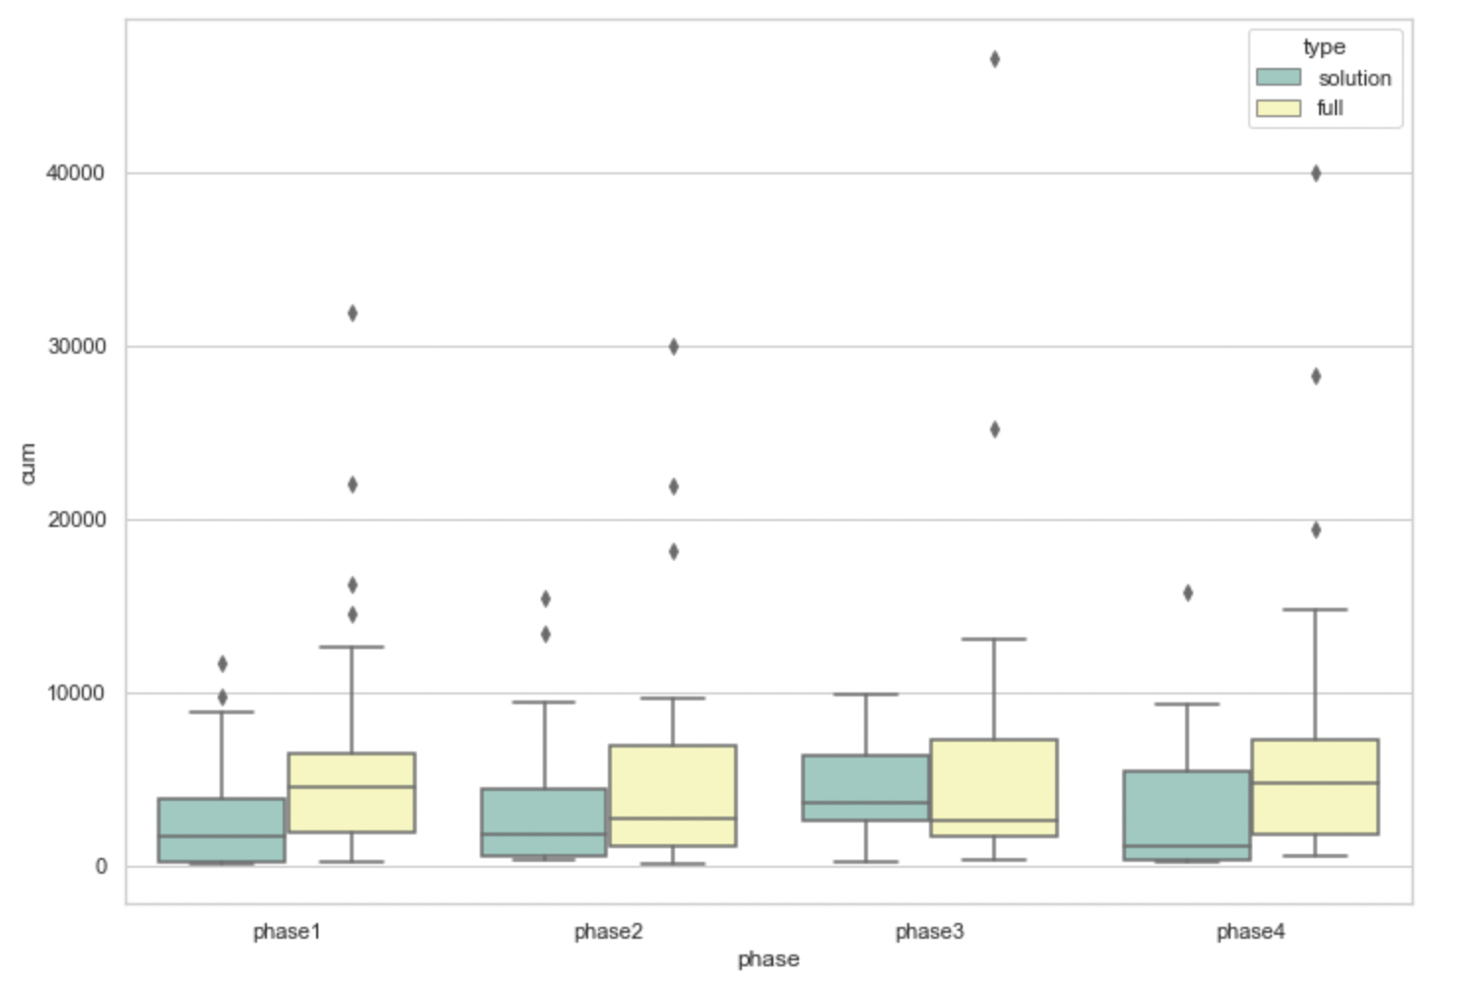
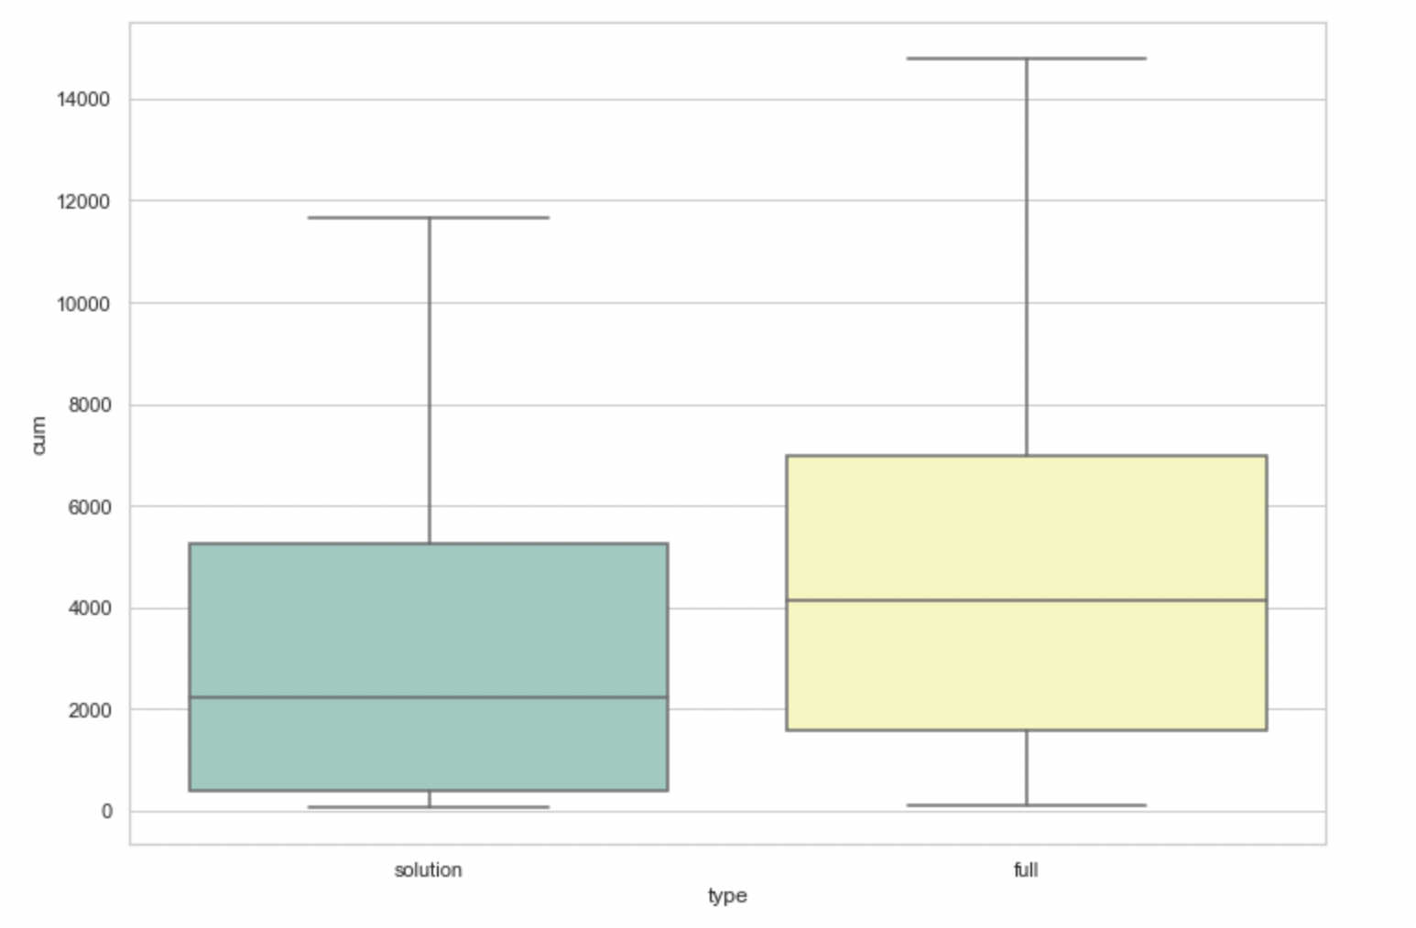
Total Score of the Apps Being Clicked Across All Phases ( box plots )
pvalue=0.00017575311061889564
( Independent T-test )

Slide 13
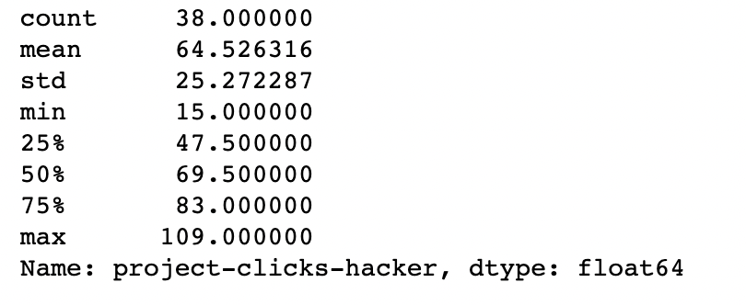
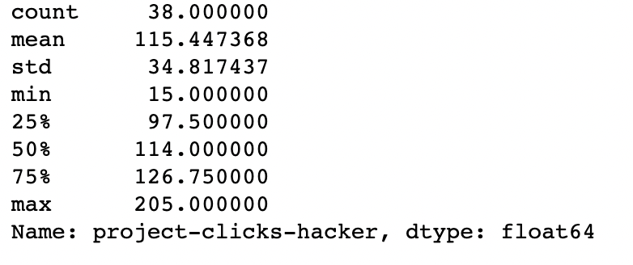
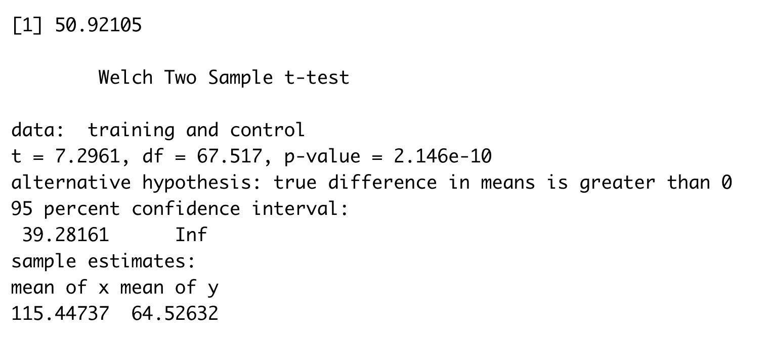
The number of clicks assigned to an app
Bogota 2 ( Solution Transparency ) | Bogota 3 ( Full Transparency )

Slide 14
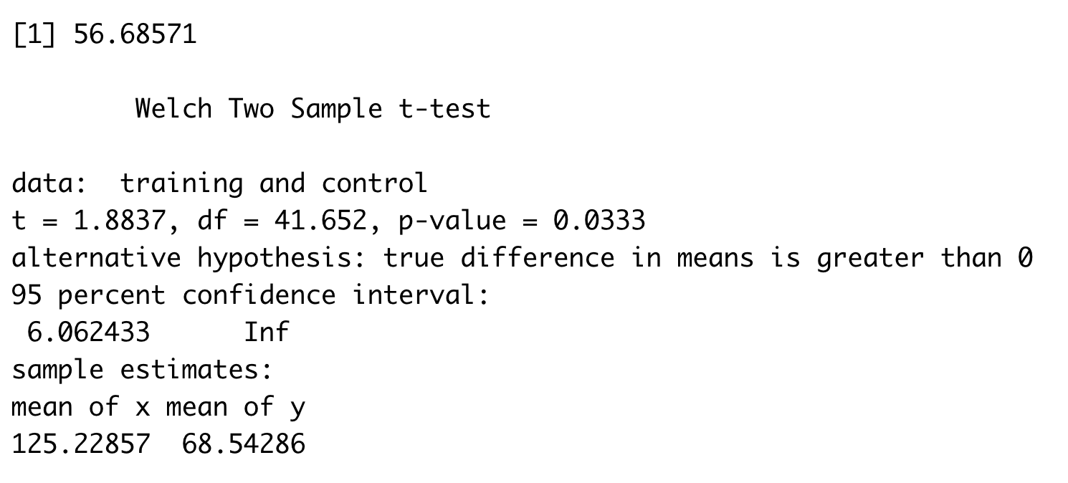
The number of clicks done by a person
Bogota 2 ( Solution Transparency ) | Bogota 3 ( Full Transparency )
Stats for Solution Transparency Min. : 1.00 1st Qu.: 32.00 Median : 55.00 Mean : 68.54 3rd Qu.: 88.00 Max. :250.00 NA's :7 | Stats for Full Transparency Min. : 1.0 1st Qu.: 43.0 Median : 60.0 Mean :125.2 3rd Qu.:128.5 Max. :821.0 NA's :6

Slide 15
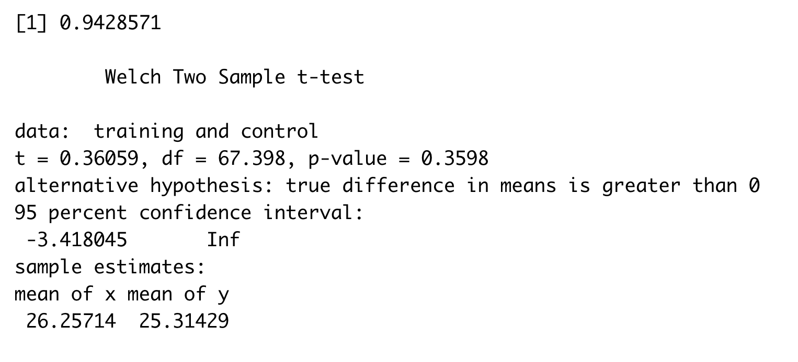
The number of unique apps explored
Bogota 2 ( Solution Transparency ) | Bogota 3 ( Full Transparency )
Stats for Solution Transparency count 35.000000 mean 25.314286 std 10.408626 min 1.000000 25% 20.500000 50% 27.000000 75% 34.500000 max 37.000000 | Stats for Full Transparency count 35.000000 mean 26.257143 std 11.443834 min 1.000000 25% 21.500000 50% 29.000000 75% 36.500000 max 38.000000

Slide 16
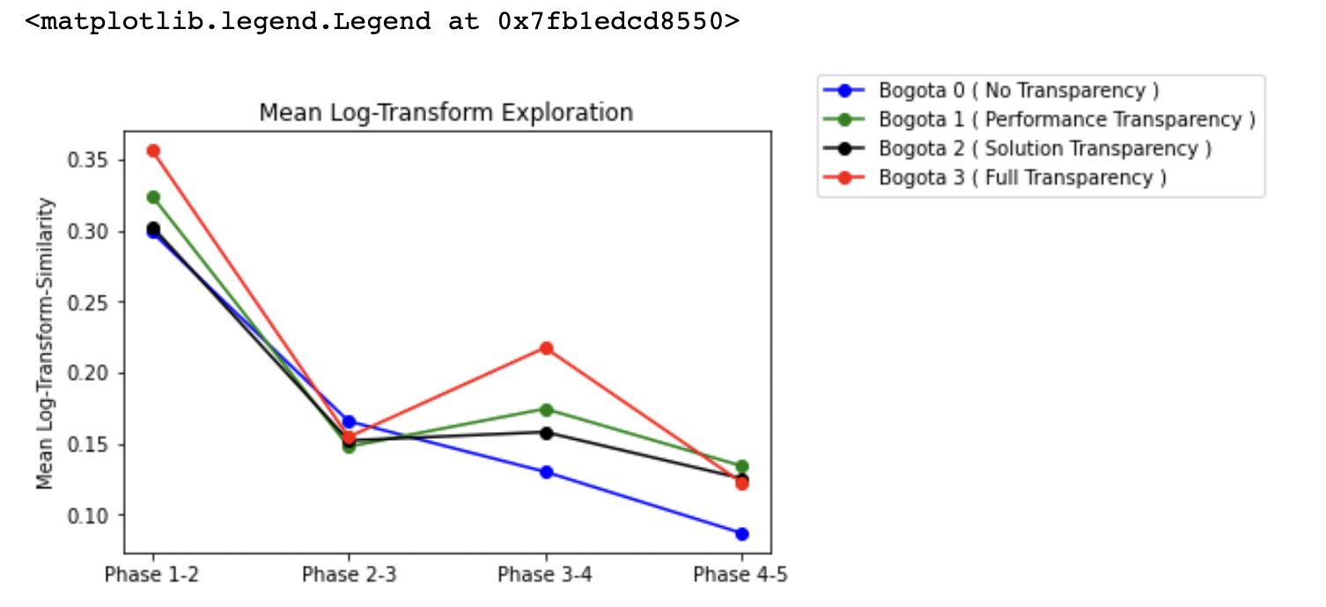
Output from Fuzzy
Individual Exploration Before ( Left ) and After Fuzzy ( Right )

Slide 17
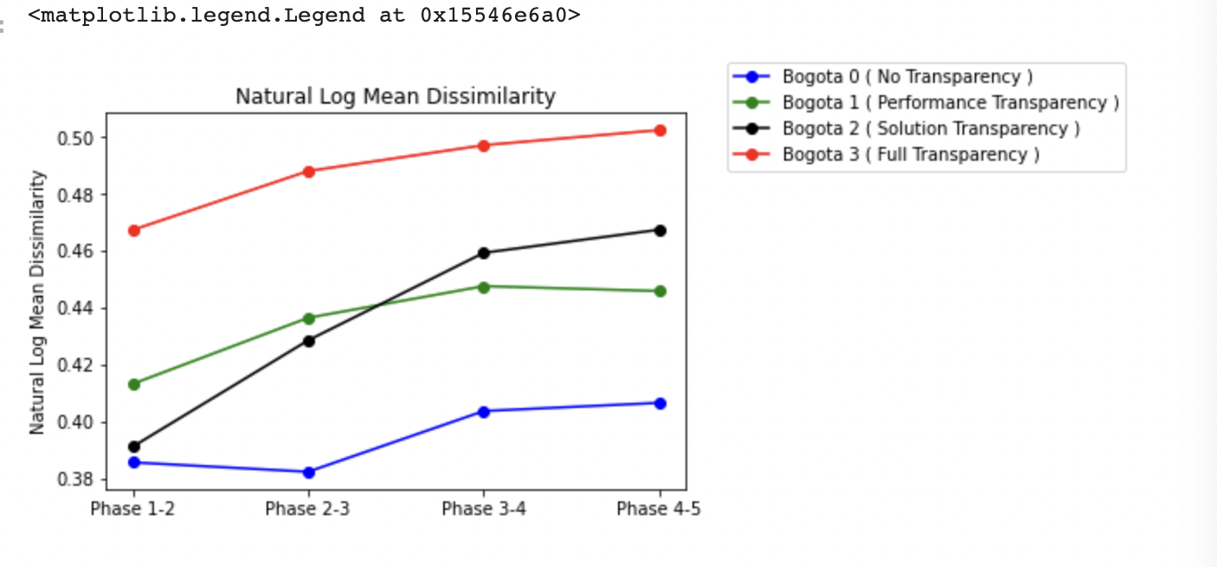
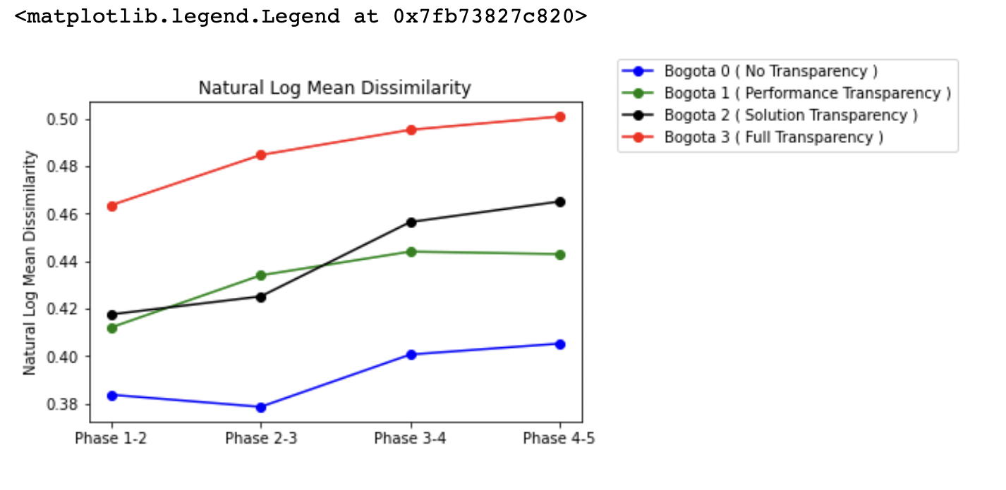
Output from Fuzzy
Dissimilarity Before ( Left ) and After Fuzzy ( Right )
Interpretation: Novelty highest in full transparency case.

Slide 18
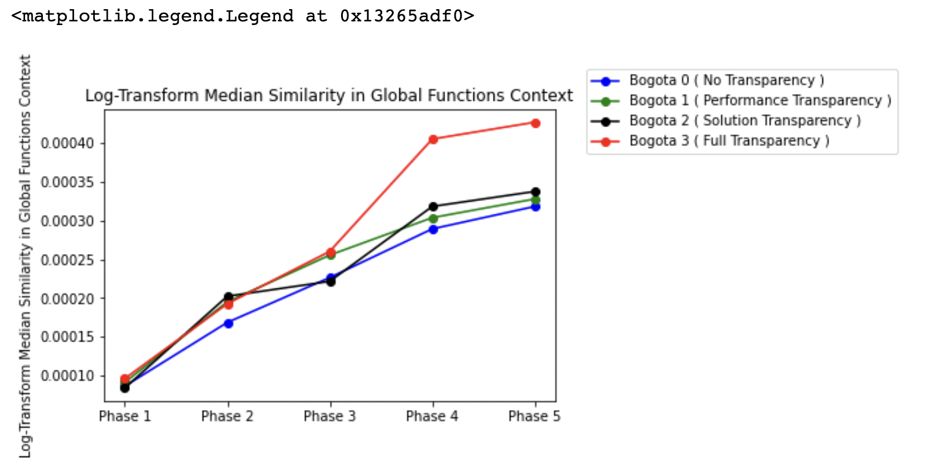
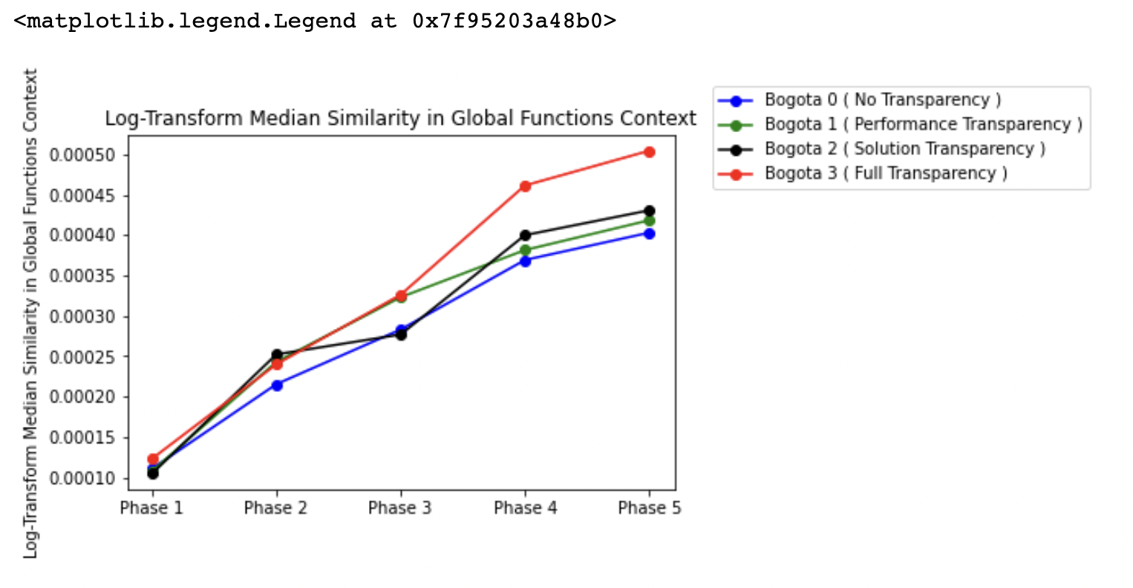
Output from Fuzzy Median Similarity in Global Functions Context Before ( Left ) and After Fuzzy ( Right )
Interpretation: A lot of functions in the global pool come from full transparency case.

Slide 19
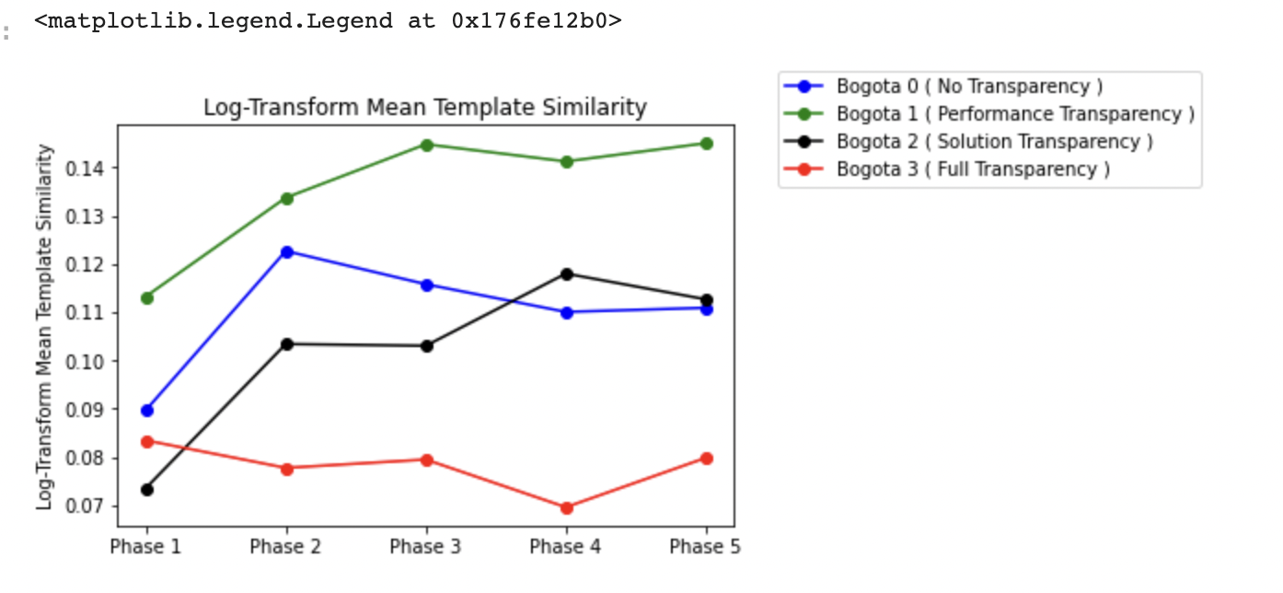
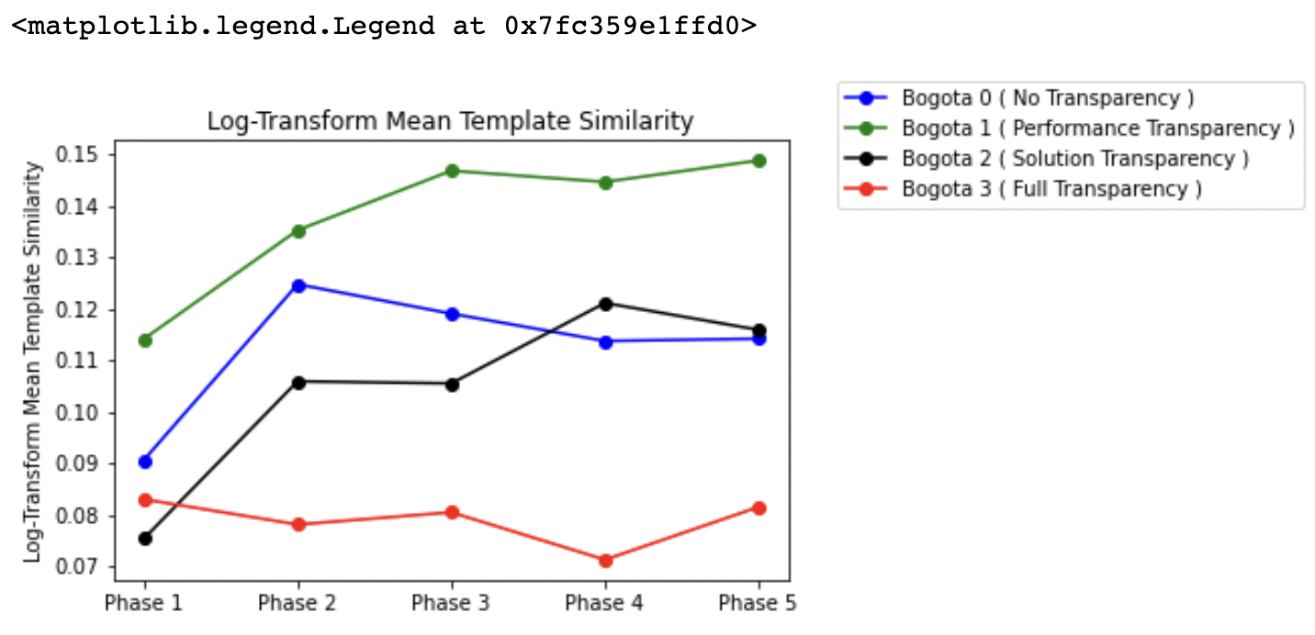
Output from Fuzzy Mean Similarity in Template Functions Context Before ( Left ) and After Fuzzy ( Right )

Slide 20
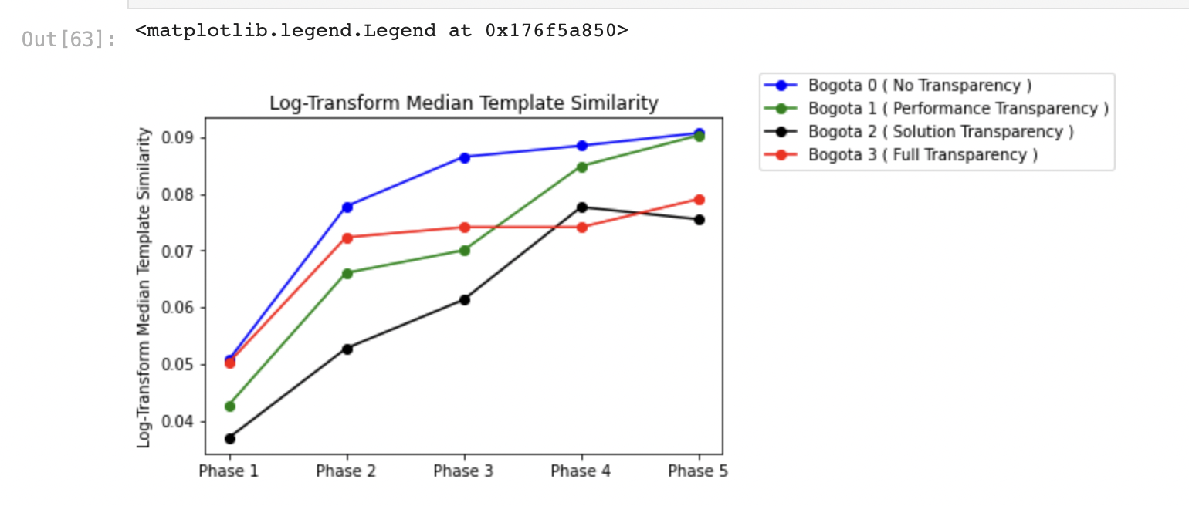
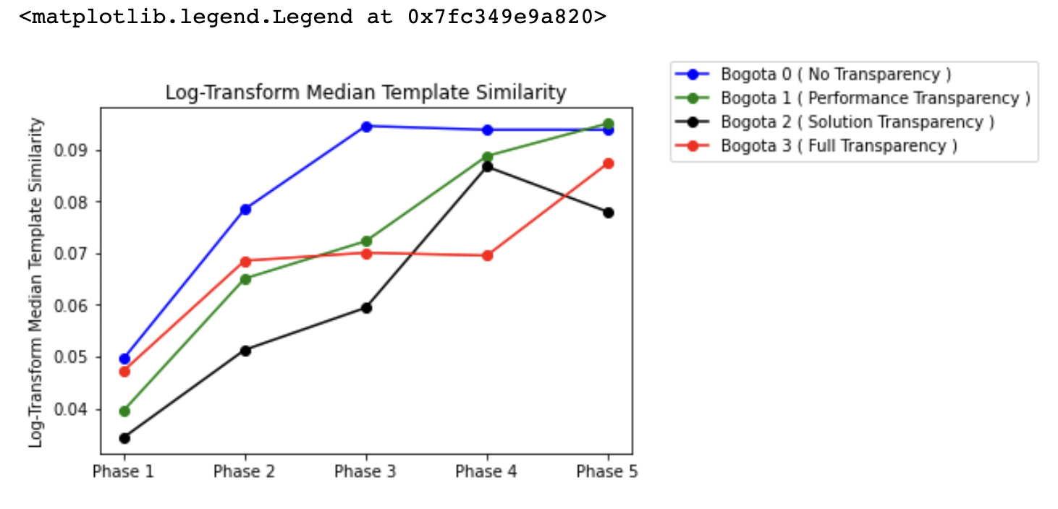
Output from Fuzzy Median Similarity in Template Functions Context Before ( Left ) and After Fuzzy ( Right )

Slide 21
Cross stage similarity metrics on an individual level (Variable Name: individual_exploration (IND_EXP))

Slide 22
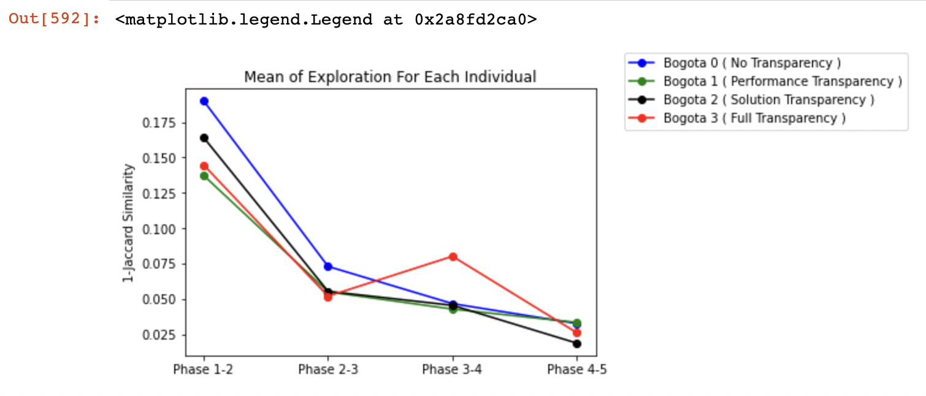
Mean Individual Exploration [ Prior Log-Transform ]

Slide 23
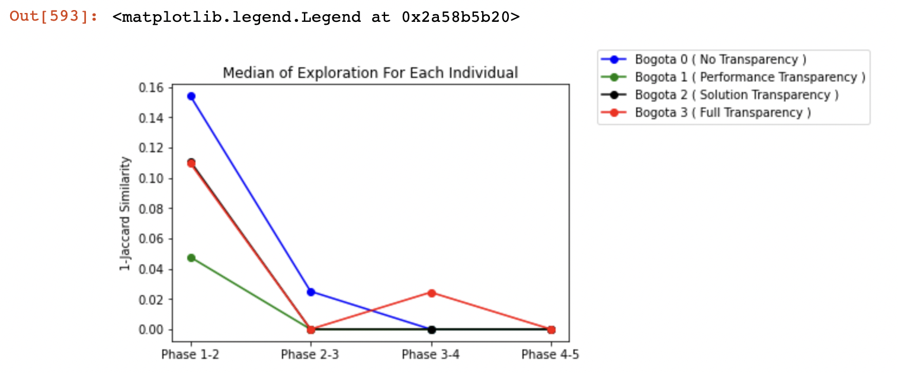
Median Individual Exploration [ Prior Log-Transform ]

Slide 24
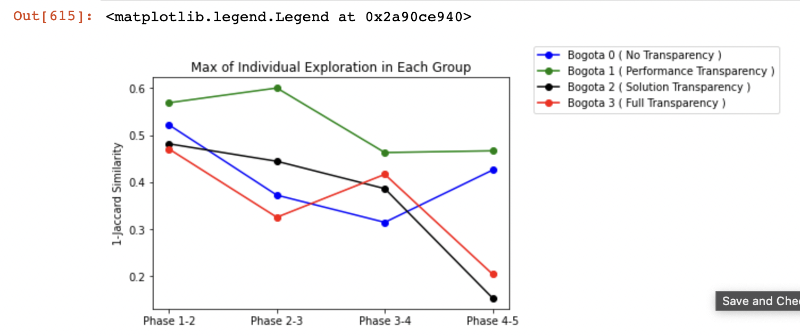
Max Individual Exploration [ Prior Log-Transform ]

Slide 28
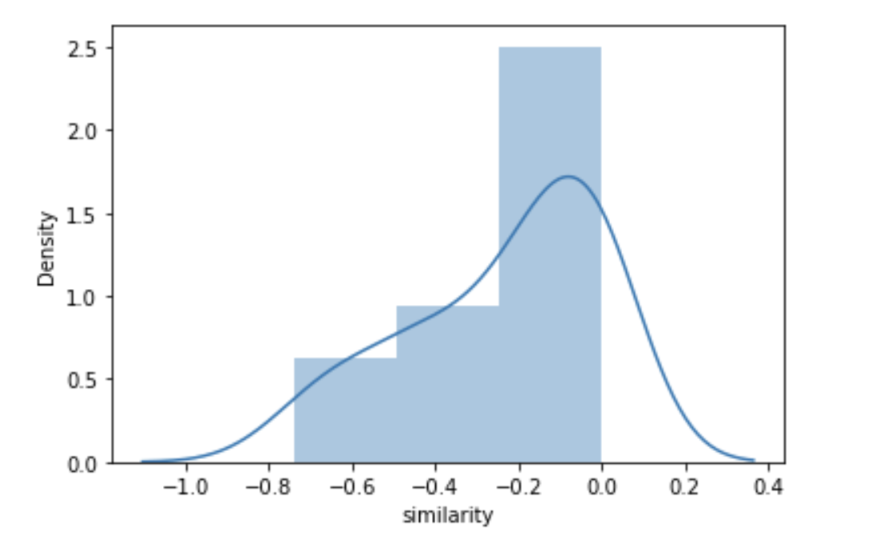
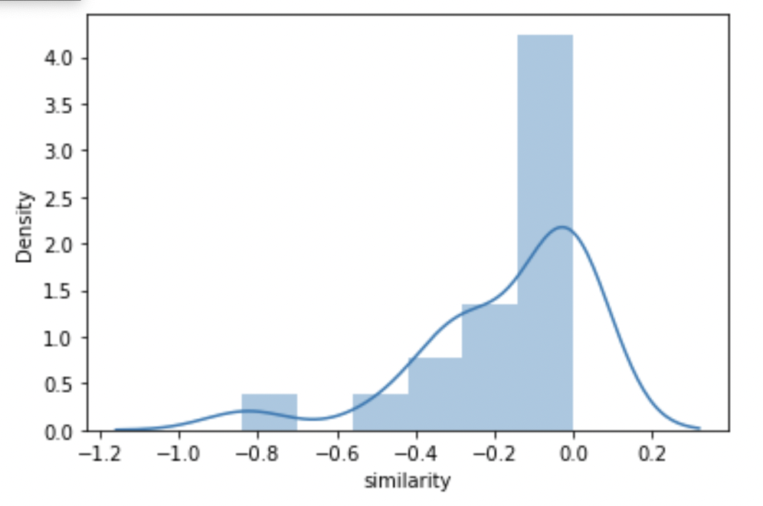
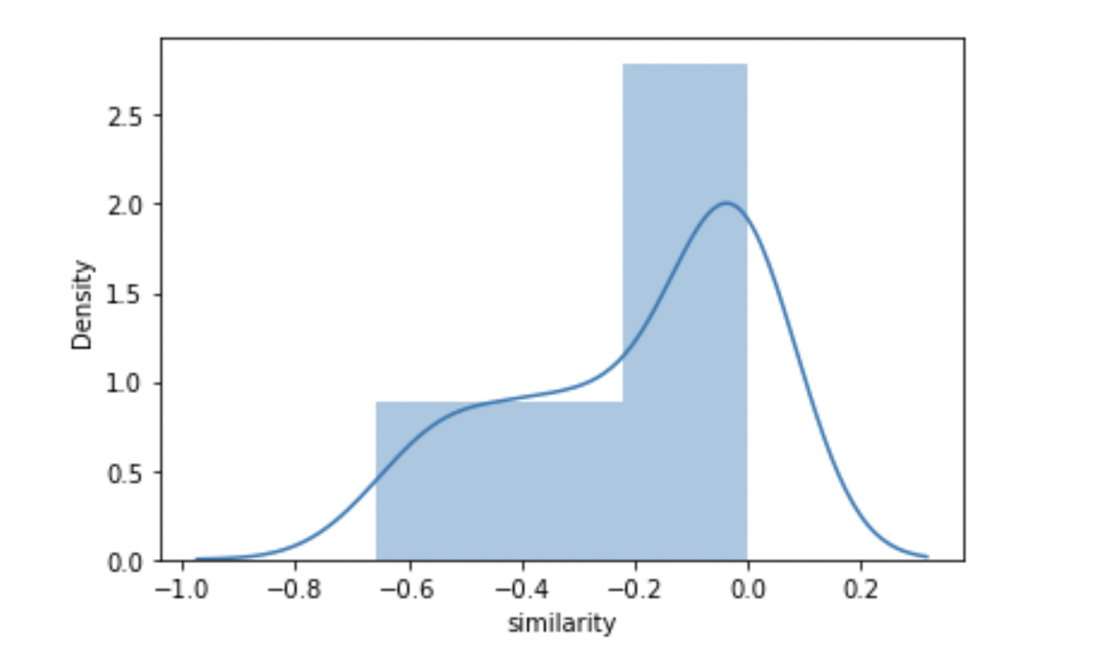
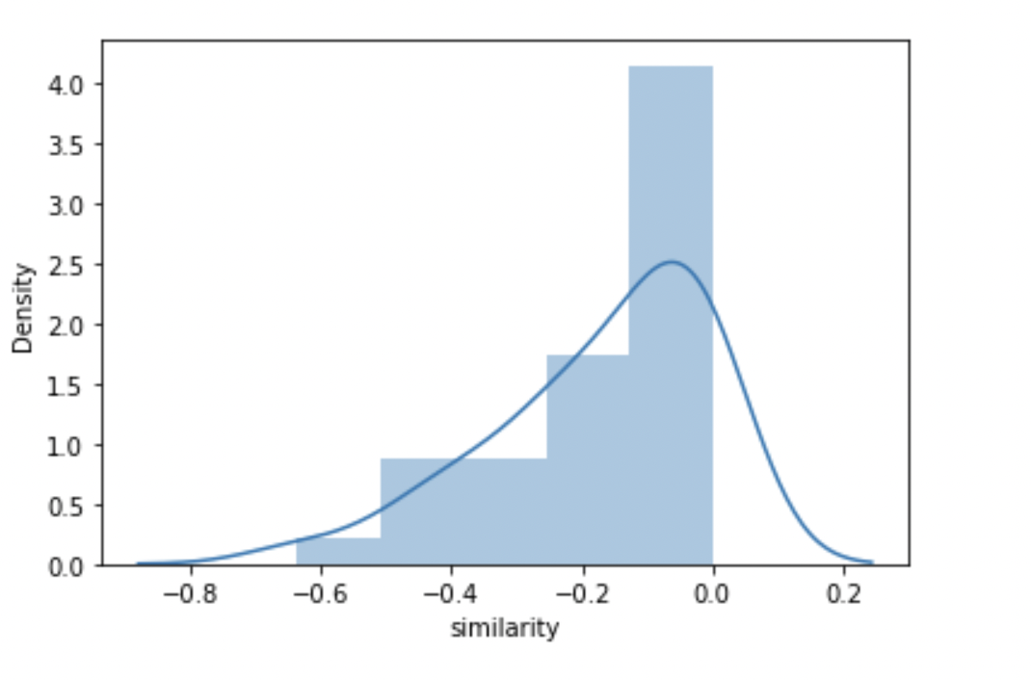
Phase 1-2 After Natural Log Transformation
Bogota 0 | Bogota 1
Bogota 2 | Bogota 3

Slide 29
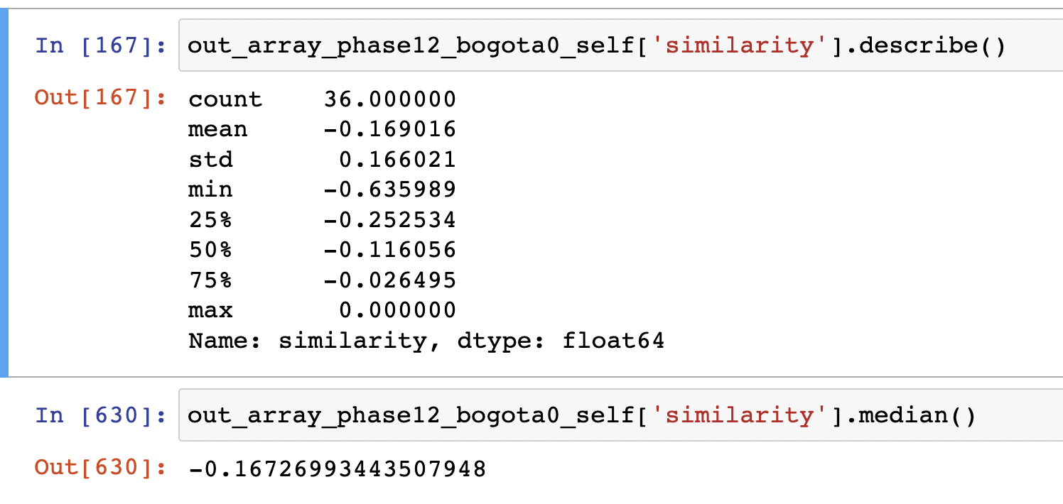
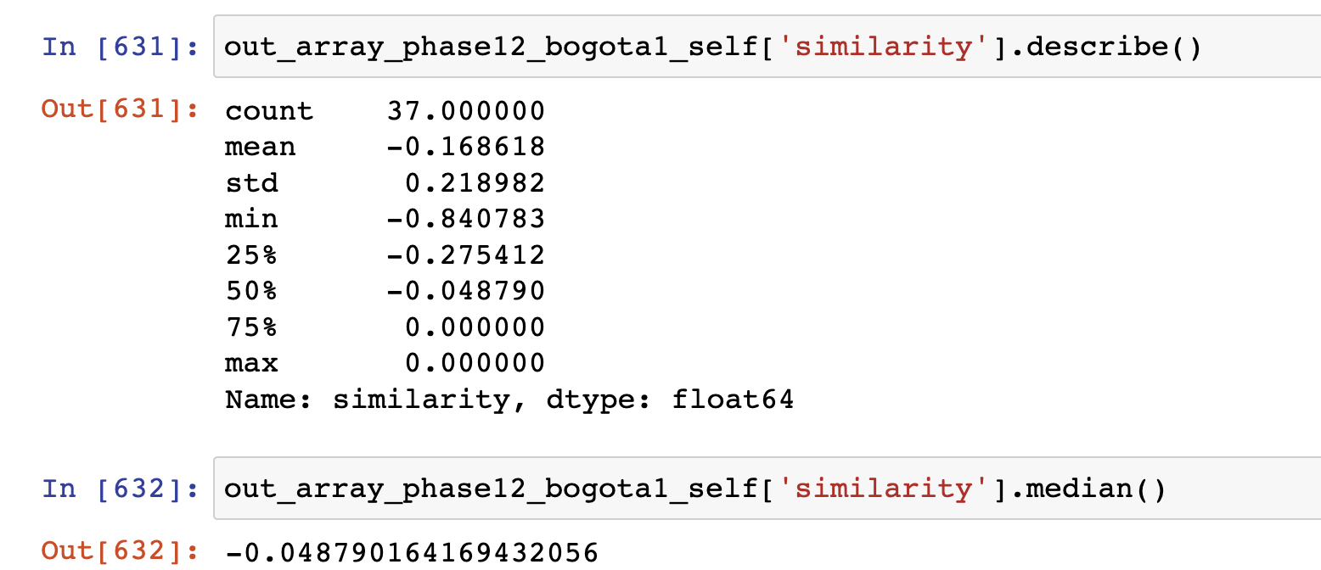
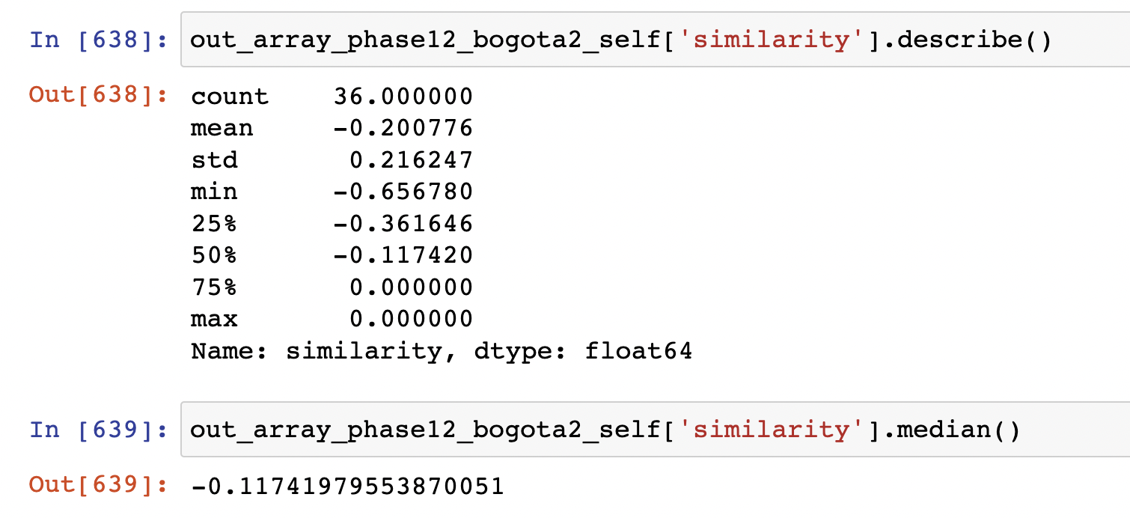
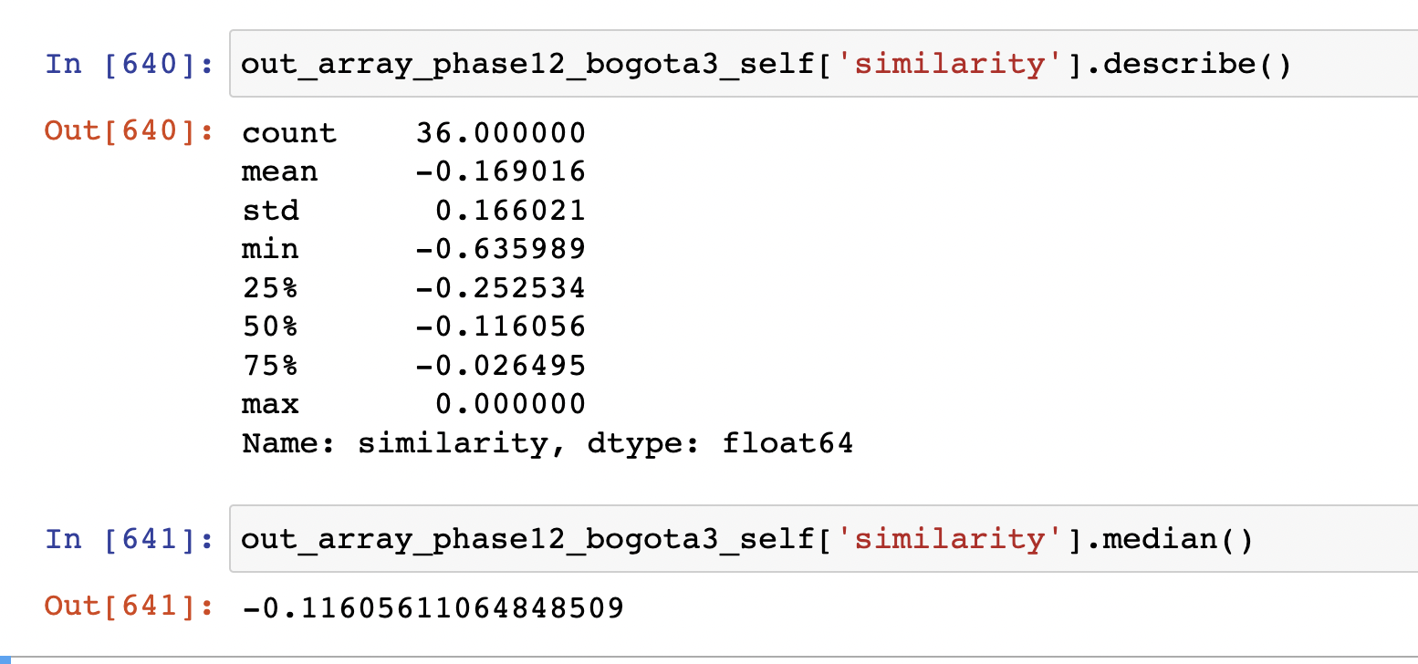
Phase 1-2 After Natural Log Transformation
Bogota 0 | Bogota 1
Bogota 2 | Bogota 3

Slide 30
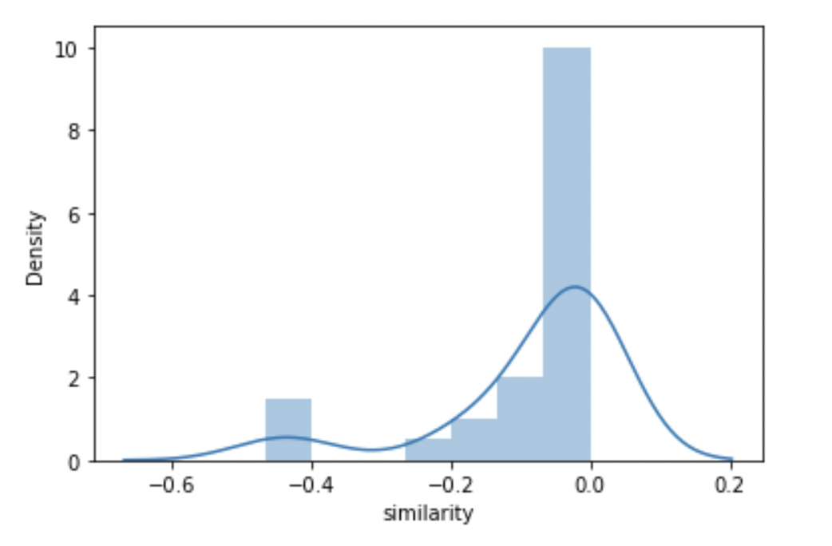
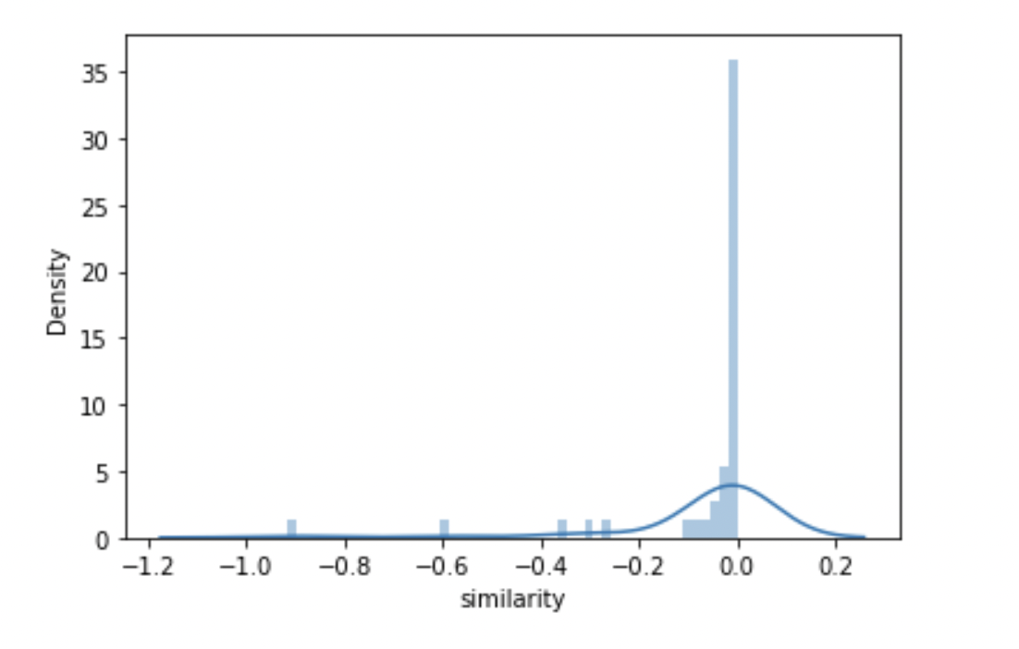


Phase 2-3 After Natural Log Transformation
Bogota 0 | Bogota 1
Bogota 2 | Bogota 3

Slide 31




Phase 2-3 After Natural Log Transformation
Bogota 0 | Bogota 1
Bogota 2 | Bogota 3

Slide 32




Phase 3-4 After Natural Log Transformation
Bogota 0 | Bogota 1
Bogota 2 | Bogota 3

Slide 33




Phase 3-4 After Natural Log Transformation
Bogota 0 | Bogota 1
Bogota 2 | Bogota 3

Slide 34




Phase 4-5 After Natural Log Transformation
Bogota 0 | Bogota 1
Bogota 2 | Bogota 3

Slide 35




Phase 4-5 After Natural Log Transformation
Bogota 0 | Bogota 1
Bogota 2 | Bogota 3

Slide 36


Total Count of Functions for Each Group

Slide 37


Total Unique Functions for Each Group

Slide 38

Median Count of Template Functions Per Individual

Slide 39

Median Template Similarity

Slide 40

Mean Count of Template Functions Per Individual

Slide 41

Mean Template Similarity

Slide 42


Distribution Plot of Template Functions Per Individual
Phase 1 | Phase 2

Slide 43


Distribution Plot of Template Functions Per Individual

Slide 44

Distribution Plot of Template Functions Per Individual

Slide 45

Median Functions Per Individual [ Variety ] [ Repetition Removed ]

Slide 46




Log Transformed Plot for Unique Functions
Bogota 3 | Bogota 2
Bogota 1 | Bogota 0

Slide 47

Median Rare Functions [ 10% Quantile ] [ Functions Level ]

Slide 48

Median Top 10% Rare Functions Per Individual [ Per Phase ]

Slide 49


Mean/Median Rare Functions [ 10% Quantile ] [ Individual Level ] [ Overall Case ]
Mean
Median

Slide 50


Mean/Median Rare Functions [ 20% Quantile ] [ Individual Level ] [ Overall Case ]

Slide 51

Distribution of Rare Functions [ 10% ] [ Individual Level ] [ Overall Case ]

Slide 52

Distribution of Rare Functions [ 20% ] [ Individual Level ] [ Overall Case ]

Slide 53

Phase 1 Error Bar for 10% Quantile

Slide 54

Phase 1 Boxplot for 10% Quantile
Extreme outliers
Potential Outliers

Slide 55

Phase 2 Error Bar for 10% Quantile

Slide 56

Phase 2 Boxplot for 10% Quantile
All outliers in this plot are ”extreme” outliers.

Slide 57

Phase 3 Error Bar for 10% Quantile

Slide 58

Phase 3 Boxplot for 10% Quantile
Extreme
Outliers
Potential Outliers

Slide 59

Phase 4 Boxplot for 10% Quantile

Slide 60

Phase 4 Error Bar for 10% Quantile
Extreme outliers
Potential outliers

Slide 61

Phase 5 Boxplot for 10% Quantile

Slide 62

Phase 5 Error Bar for 10% Quantile

Slide 63
Phase 1 Outliers [ Variety Unique Functions ] [ Repetition Removed ] [ Individual ]
Bogota 0 | Bogota 1 | Bogota 2 | Bogota 3
100 < X < 200 Count = 1 | 100 < X < 200 Count = 4 | 100 < X < 200 Count = 1 | 100 < X < 200 Count = 2
 | 200 < X < 300 Count = 1 | 500 < X < 600 Count = 1 | 30,000 < X < 40,000 Count = 1
 | 300 < X < 400 Count = 1 | 30,000 < X < 40,000 Count = 1 | 70,000 < X < 80,000 Count = 1

Slide 64
Phase 2 Outliers [ Variety Unique Functions ] [ Repetition Removed ] [ Individual ]
Bogota 0 | Bogota 1 | Bogota 2 | Bogota 3
100 < X < 200 Count = 1 | 100 < X < 200 Count = 6 | 100 < X < 200 Count = 3 | 100 < X < 200 Count = 2
7000 < X < 8000 Count = 1 | 200 < X < 300 Count = 1 | 400 < X < 500 Count = 1 | 300 < X < 400 Count = 1
 | 300 < X < 400 Count = 1 | 500 < X < 600 Count = 1 | 2,000 < X < 3,000 Count = 1
 | 1000 < X < 2000 Count = 1 | 2,000 < X < 3,000 Count = 2 | 30,000 < X < 40,000 Count = 1
 | 2000 < X < 3000 Count = 3 | 3,000 < X < 4,000 Count = 1 | 70,000 < X < 80,000 Count = 1
 | 20,000 < X < 30,000 Count = 1 | 30,000 < X < 40,000 Count = 1
 | 70,000 < X < 80,000 Count = 1

Slide 65
Phase 3 Outliers [ Variety Unique Functions ] [ Repetition Removed ] [ Individual ]
Bogota 0 | Bogota 1 | Bogota 2 | Bogota 3
100 < X < 200 Count = 1 | 100 < X < 200 Count = 6 | 100 < X < 200 Count = 4 | 100 < X < 200 Count = 4
2000 < X < 3000 Count = 1 | 200 < X < 300 Count = 2 | 400 < X < 500 Count = 1 | 200 < X < 300 Count = 1 300 < X < 400 Count = 1
7000 < X < 8000 Count = 1 | 300 < X < 400 Count = 1 700 < X 800 Count = 1 | 500 < X < 600 Count = 1 | 2,000 < X < 3,000 Count = 2
 | 1000 < X < 2000 Count = 1 | 2,000 < X < 3,000 Count = 3 | 30,000 < X < 40,000 Count = 1
 | 2000 < X < 3000 Count = 3 | 4,000 < X < 5,000 Count = 1 | 70,000 < X < 80,000 Count = 1
 | 20,000 < X < 30,000 Count = 1 | 30,000 < X < 40,000 Count = 1
 | 80,000 < X < 90,000 Count = 1

Slide 66
Phase 4 Outliers [ Variety Unique Functions ] [ Repetition Removed ] [ Individual ]
Bogota 0 | Bogota 1 | Bogota 2 | Bogota 3
100 < X < 200 Count = 1 | 100 < X < 200 Count = 6 | 100 < X < 200 Count = 3 | 100 < X < 200 Count = 2
7000 < X < 8000 Count = 1 | 200 < X < 300 Count = 1 | 400 < X < 500 Count = 1 | 300 < X < 400 Count = 1
 | 300 < X < 400 Count = 1 | 500 < X < 600 Count = 1 | 2,000 < X < 3,000 Count = 1
 | 1000 < X < 2000 Count = 1 | 2,000 < X < 3,000 Count = 2 | 30,000 < X < 40,000 Count = 1
 | 2000 < X < 3000 Count = 3 | 3,000 < X < 4,000 Count = 1 | 70,000 < X < 80,000 Count = 1
 | 20,000 < X < 30,000 Count = 1 | 30,000 < X < 40,000 Count = 1
 | 70,000 < X < 80,000 Count = 1

Slide 67
Phase 5 Outliers [ Variety Unique Functions ] [ Repetition Removed ] [ Individual ]
Bogota 0 | Bogota 1 | Bogota 2 | Bogota 3
100 < X < 200 Count = 1 | 100 < X < 200 Count = 6 | 100 < X < 200 Count = 3 | 100 < X < 200 Count = 2
7000 < X < 8000 Count = 1 | 200 < X < 300 Count = 1 | 400 < X < 500 Count = 1 | 300 < X < 400 Count = 1
 | 300 < X < 400 Count = 1 | 500 < X < 600 Count = 1 | 2,000 < X < 3,000 Count = 1
 | 1000 < X < 2000 Count = 1 | 2,000 < X < 3,000 Count = 2 | 30,000 < X < 40,000 Count = 1
 | 2000 < X < 3000 Count = 3 | 3,000 < X < 4,000 Count = 1 | 70,000 < X < 80,000 Count = 1
 | 20,000 < X < 30,000 Count = 1 | 30,000 < X < 40,000 Count = 1
 | 70,000 < X < 80,000 Count = 1

Slide 68

Count of Least Common Functions ( Top 5% )

Slide 69

Count of Least Common Functions ( Top 10% )

Slide 70

Count of Unique Functions ( Top 15% )

Slide 71

Count of Unique Functions ( Top 20% )

Slide 72

Distribution Plot for Exploration Metric [ Full Transparency ]

Slide 73

Distribution Plot for Exploration Metric [ Solution Transparency ]

Slide 74

Distribution Plot for Exploration Metric [ Performance Transparency ]

Slide 75

Distribution Plot for Exploration Metric [ No Transparency ]

Slide 76

Mean of the highest similarity score to the other person

Slide 77

Median of the highest similarity score to the other person

Slide 78

Mean Dissimilarity in Global Functions Context

Slide 79

Median Dissimilarity in Global Functions Context

Slide 80

Minimum Dissimilarity in Global Functions Context

Slide 81

Overlap of No Transparency Case with All Others

Slide 82

Overlap of No Transparency Case with All Others

Slide 83

Overlap of No Transparency Case with All Others

